Slide 1
Brain Drain: Neurological Considerations of Brain Drain
Donald L. Hilton, Jr, MD, FAANS
Adjunct Associate Professor of Neurosurgery
University of Texas Health Science Center at San Antonio

Slide 2


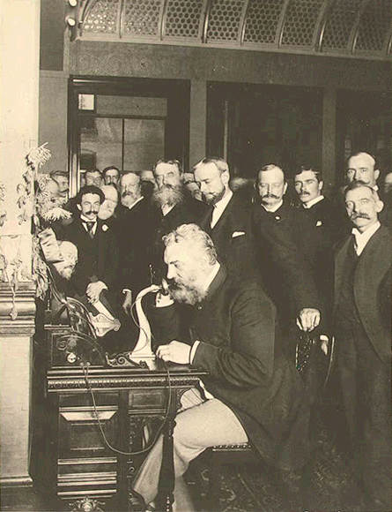
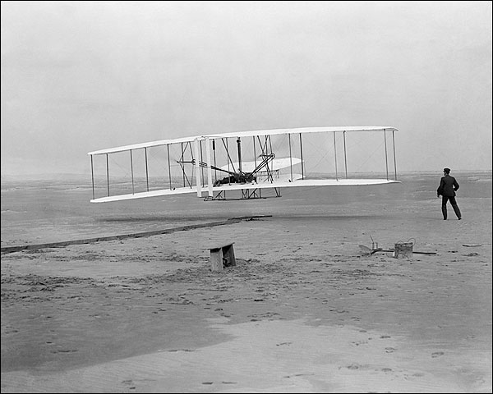
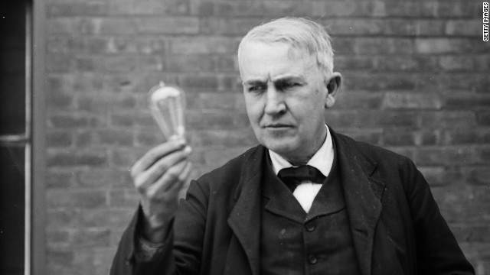






Slide 7


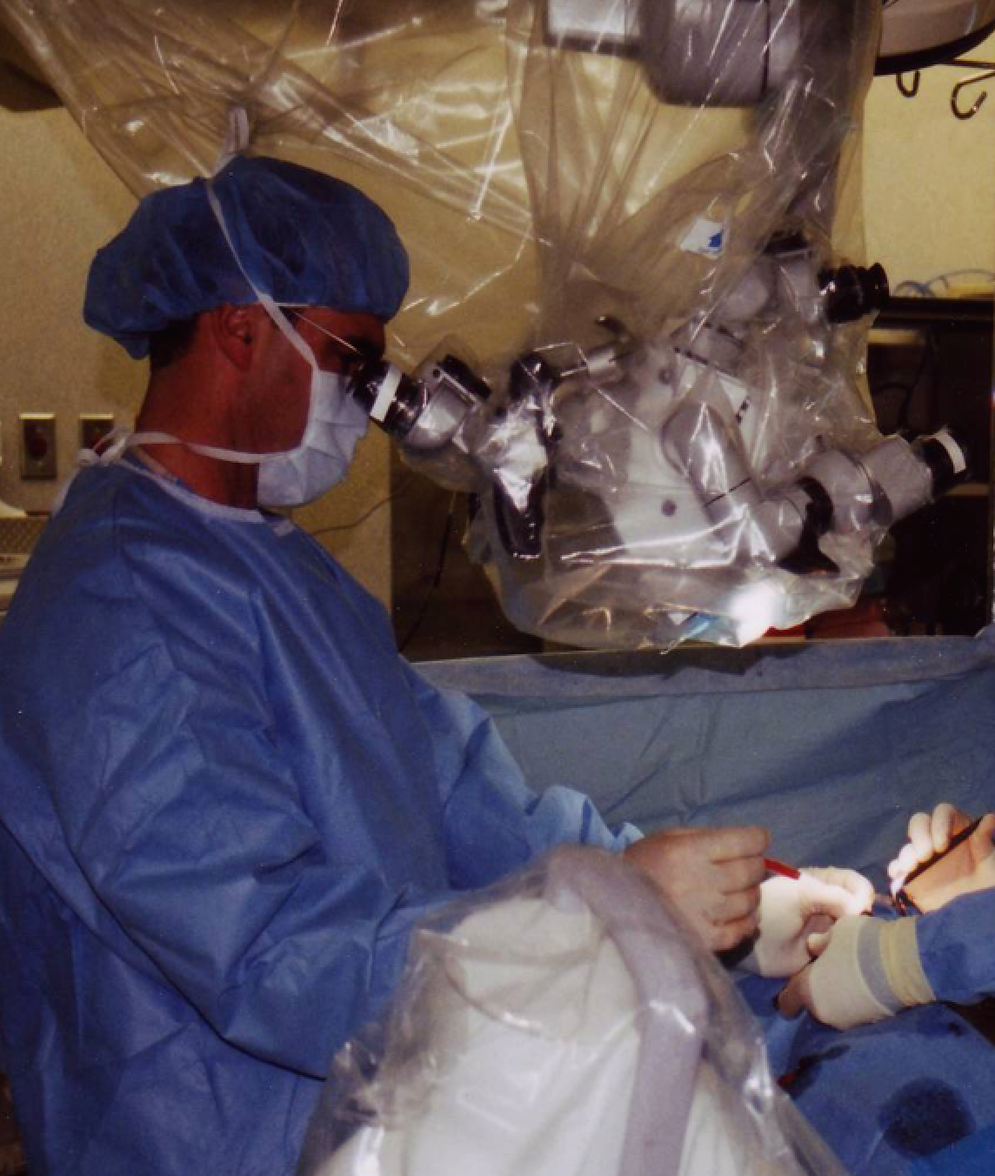

Focus

Slide 8
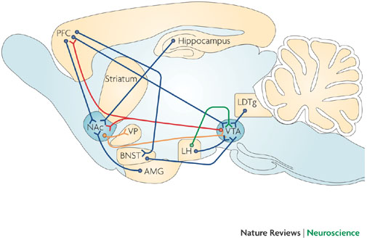

Slide 9
Effects of Drugs on Dopamine Release
AMPHETAMINE
COCAINE
1100
Accumbens
Accumbens
1000
400
900
800
DA
300
DA
700
DOPAC
DOPAC
% of Basal Release
HVA
HVA
600
% of Basal Release
500
200
400
300
200
100
100
0
0
0
1
2
3
4
5 hr
0
1
2
3
4
5 hr
Time After Amphetamine
Time After Cocaine
250
NICOTINE
MORPHINE
250
Accumbens
Dose (mg/kg)
200
Accumbens
200
0.5
Caudate
1.0
% of Basal Release
2.5
150
% of Basal Release
10
150
100
100
0
0
0
1
2
3 hr
0
1
2
3
4
5hr
Time After Nicotine
Time After Morphine
Di Chiara and Imperato, PNAS, 1988
Notes:
Drugs of abuse increase dopamine neurotransmission. All the drugs depicted in this slide have different mechanisms of action; however, all increase activity in the reward pathway by increasing dopamine neurotransmission. Because drugs activate these brain regions⎯usually more effectively than natural rewards⎯they have an inherent risk of being abused.

Slide 10
Natural Rewards Elevate Dopamine Levels
FOOD
SEX
200
200
NAc shell
150
150
DA Concentration (% Baseline)
100
100
% of Basal DA Output
15
Empty
10
50
Box
Feeding
Copulation Frequency
5
0
0
0
60
120
180
Female Present
Time (min)
Sample
Number
1
2
3
4
5
6
7
8
Mounts
Intromissions
Ejaculations
Di Chiara et al., Neuroscience, 1999.
Fiorino and Phillips, J. Neuroscience, 1997.
Notes:
Natural rewards increase dopamine neurotransmission. For example, eating something that you enjoy or engaging in sexual behavior can cause dopamine levels to increase. In these graphs, dopamine is being measured inside the brains of animals, its increase shown in response to food or sex cues. This basic mechanism has been carefully shaped and calibrated by evolution to reward normal activities critical for survival.

Slide 11
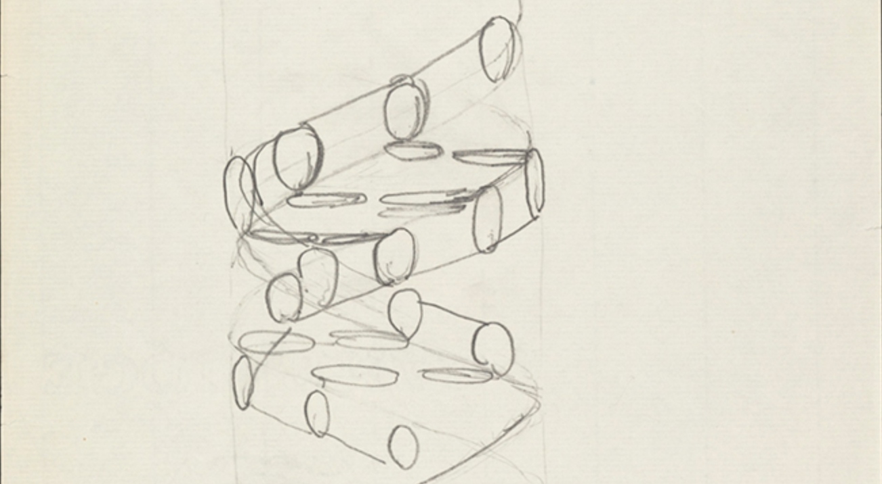
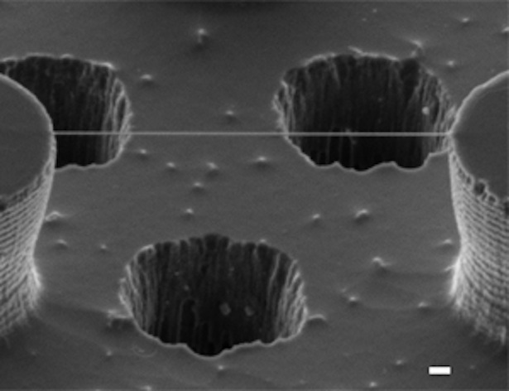
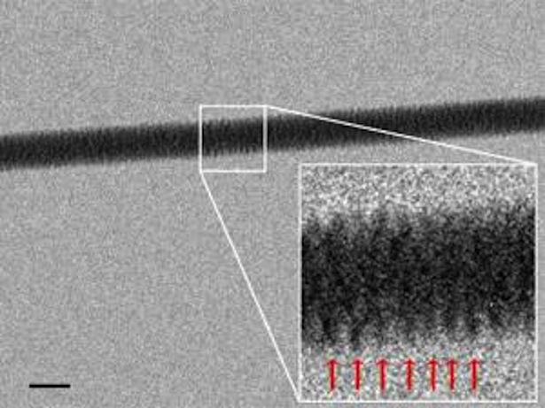
It’s in your DNA!
Francis Crick’s
circa 1953 sketch of DNA
Gentile, et al.
Nanoletters, 2012
University of Genoa

Slide 12
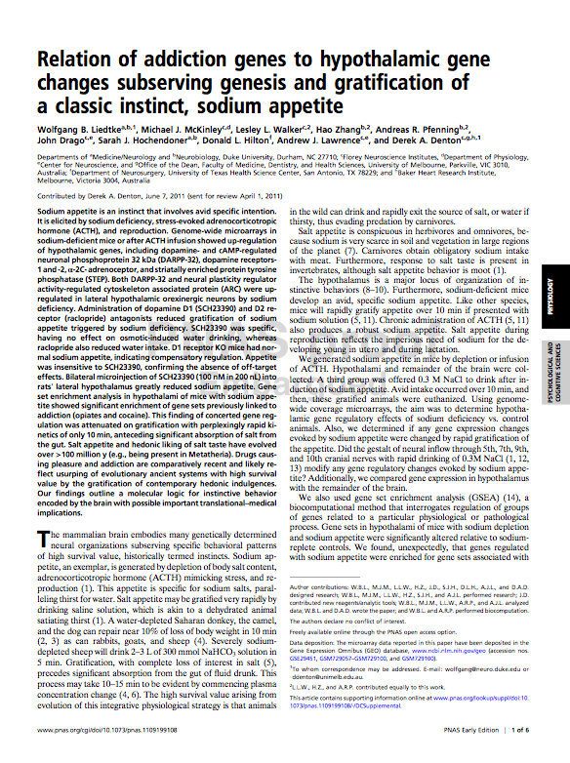
…”usurping” of pleasure reward systems important in survival…
Proceedings of the National Academy of Sciences (PNAS, 2011)
Notes:
. This is not surprising in light of a recent paper published last year in the Journal of the Proceedings of the National Academy of Sciences (PNAS) in which I was a co-author titled “Relation of addiction genes to hypothalamic gene changes subserving genesis and gratification of a classic instinct, sodium appetite.” We found that sodium depletion kindled expression of genes in the hypothalamus important in reward and neuroplasticity. Importantly, we found that blocking dopamine receptors decreased gratification by depressing reward incentive. Using gene set enrichment analysis we found that these same gene sets, that is the ones mobilized by salt craving, are the same gene sets previously linked to cocaine and opiates. Of course, salt craving has of necessity phylogenetically conserved across all in biologic systems, whereas drug craving is the newcomer. As worded in our paper, “Drugs causing pleasure and addiction are comparatively recent and likely reflect usurping of … ancient systems with high survival value by the gratification of contemporary hedonic indulgences.” National Geographic described our paper as follows: “Cocaine Addiction Uses Same Brain Paths as Salt Craving,” saying “Drugs hijack instinctual need for salt.”
I think our word “usurp” and their word “hijack” are accurate and descriptive with regard to what happens in addiction. These powerful survival cravings ensure that we will seek out these rewards or we will perish as individual organisms and as a species. Drug addiction usurps and hijacks these pathways and lies to the brain, telling the organism that it will die, it will perish, it if does not satiate the craving. Hence the difficulty with overcoming addiction though willpower alone, and the fallacy of trying to understand all addiction behaviorally without understanding or considering biology!

Slide 13
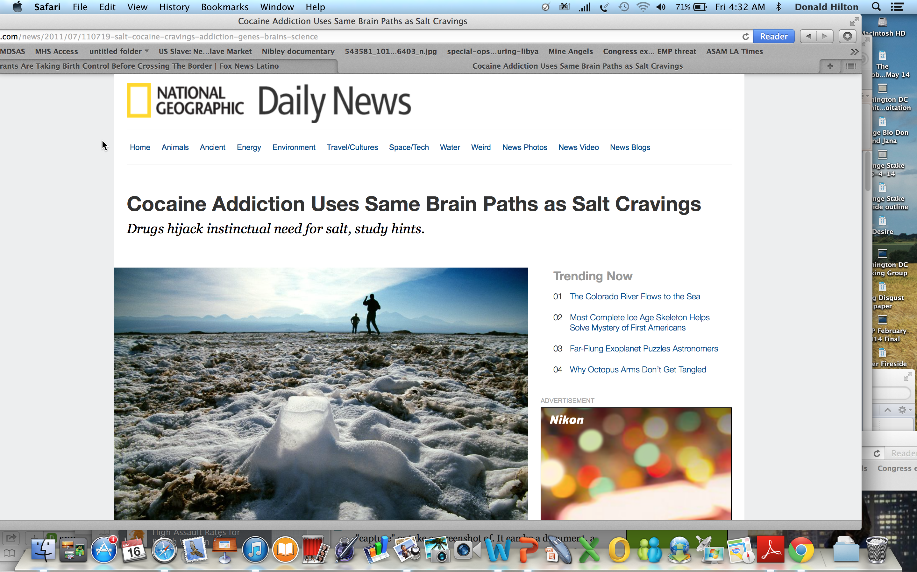

Slide 14

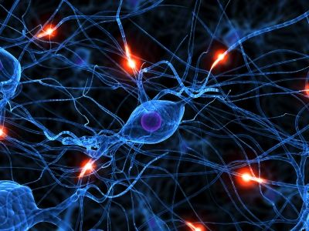
DeltaFosB- a molecular switch which turns on a powerful reward learning “signaling cascade”

Slide 15
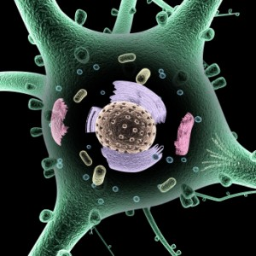
Thinking “Changes” Your Brain!
A thought occurs! Instantly, the signal goes out, DNA is triggered and coding of RNA begins. Pieces of RNA are brought together and edited. Some large RNAs travel to the ribosome manufacturing proteins for microtubules and actin, transporting sacs holding neurotransmitters, building structures to seamlessly merge sacs with the cell membrane releasing the neurotransmitters. Other smaller RNA’s fan out across the cell, regulating every aspect of the process. As the dendrite is built, soon a synapse appears with another neuron. The elaborate synapse structure emerges between the two neurons.
A mental event has triggered an enormous molecular cascade.
Jon Lieff, MD

Slide 16
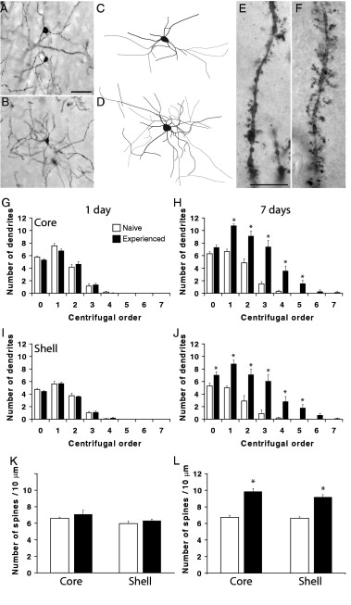
Images from Pitchers et al., 2010, Biological Psychiatry
Induction of Salt Appetite Alters
Dendritic Morphology in Nucleus
Accumbens and Sensitizes Rats
to Amphetamine
Roitman et al., 2002
Natural and Drug Rewards act on common neural plasticity mechanisms with DeltaFosB as a key mediator
Pitchers et al., 2013
Notes:
Significantly, sexual activity has been found to produce dendritic arborization as well. That sex can produce neuroplastic cellular changes identical to drug addiction is telling, both from the survival/incentive and the addiction perspectives.
These switches are involved in producing visible neuroplastic change in neuronal populations specific to incentive pathways. Nature thus ensures that we will seek activities that support our survival, such as eating and sex. Salt is essential to our survival, and there is an interesting correlation with addiction and salt. Salt depletion causes a strong craving in animals so depleted, and this is also associated with similar dendritic changes in nerve cells to those already discussed with sex and drugs. That salt and sex craving both are associated with neuroplastic change is not surprising from a survival standpoint; both are essential in this regard. We have mentioned that dendritic sprouting has been seen in these neuronal populations in drug rewards such as cocaine or amphetamine, and in natural rewards such as sex. Salt depletion, like sex, has cross-sensitization effects to drugs as well.

Slide 17
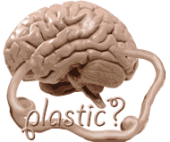
http://whyfiles.org/138memory/3.html

Slide 18

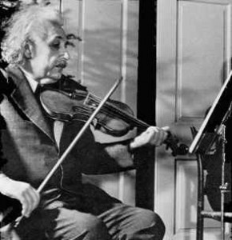

Visible Neuroplasticity – Brain Footprints
Elbert et. al. Science 1995 – Increased use of the left hand in string players increases the corresponding cortical grey matter representing the fingers of the players; this finding is increased with earlier onset of training.
Schwenkreis et .al. Eur J NeurSci 2007 - “cortical asymmetries are the result of use-dependent plasticity as a specific consequence of extensive musical practice.”
Draganski et. al. Neuroimage, 2006 – gray matter increased in medical students after a 3 month period of intense studying in both the hippocampus and the parietal lobes.
Notes:
In 1995 the Elbert study published in Science demonstrated that increased use of the left hand in string players increased the corresponding cortical grey matter representing the fingers of the players, and this causative enlargement was dependent on the age at which the musician began studying. Draganski’s paper in Nature describes how structural changes in grey matter are induced by training, and Draganski and May summarized in Behavioral Brain Research in 2008: ““Contrary to assumptions that changes in brain networks are possible only during critical periods of development, modern neuroscience adopts the idea of a permanently plastic brain.” The Schwenkreis study in 2007 demonstrated representative enlargement of the motor cortex associated with the left hand in violin players as compared to controls in support of the Elbert paper, and these authors summarized that “cortical asymmetries are the result of use-dependent plasticity as a specific consequence of extensive musical practice. Other studies reveal this cortical plasticity with use or disuse., Draganski and associates paper demonstrated increase in gray matter in medical students after a three month period of intense studying in the hippocampii and in the parietal lobes. The premise that the brain changes both micro and macroscopically with learning is accepted by those esoteric to the field of neuroscience with little debate. Learning changes the brain, and we can image this structurally.

Slide 19
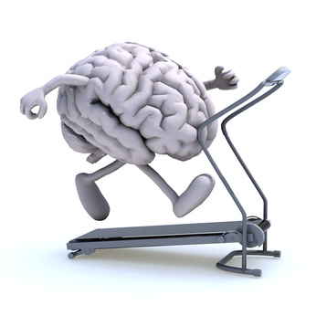
Neuroplasticity
“The brain is the source of behavior, but in turn it is modified by the behaviors it produces…
…learning sculpts brain structure.”
Zatorre et.al., Nature Neuroscience 2012
Notes:
Can behavior change the brain macroscopically? Of course! As Zatorre and collegues said in their Nature Neuroscience paper on neuroplasticity: “The brain is the source of behavior, but in turn it is modified by the behaviors it produces…
…learning sculpts brain structure.” That DeltaFosB mediated neuronal dendridic scaffolding preceeds macroscopic gyral sculpting has become clear.

Slide 20
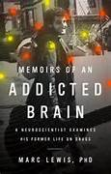

“Good old dopamine, the chemical mover that gets us to chase after whatever it is we want, whatever spells relief. For starving animals, dopamine makes the brain a vehicle for seeking food; for addicts, it send the brain hunting for drugs. In fact, dopamine-powered desperation can change the brain forever, because its message of intense wanting narrows the field of synaptic change, focusing it like a powerful microscope on one particular reward. Whether in the service of food or heroin, love or gambling, dopamine forms a rut, a line of footprints in the neural flesh. And those footprints harden and become indelible, beating an intractable path to a highly specialized – and limited – pot of gold.”
Marc Lewis, Memoirs of an Addicted Brain; A Neuroscientist Examines His Former Life on Drugs. Public Affairs, New York. 2011 pg 156.
Notes:
Before he gained his PhD and became a well-published neuroscientist, Dr. Marc Lewis experienced addiction to virtually every drug imaginable. He wrote of his experiences in a book, “Memoirs of an Addicted Brain.” He describes what the drug trips of the various drugs were like, and details how the cravings that led him to relapse over and over felt. He then explains the neuroscience behind the sensations and cravings. He said, ““Good old dopamine, the chemical mover that gets us to chase after whatever it is we want, whatever spells relief. For starving animals, dopamine makes the brain a vehicle for seeking food; for addicts, it send the brain hunting for drugs. In fact,dopamine-powered desperation can change the brain forever, because its message of intense wanting narrows the field of synaptic change, focusing it like a powerful microscope on one particular reward. Whether in the service of food or heroin, love or gambling, dopamine forms a rut, a line of footprints in the neural flesh. And those footprints harden and become indelible, beating an intractable path to a highly specialized – and limited – pot of gold.”

Slide 21
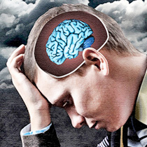
Addiction represents a pathological, yet powerful, form of learning and memory.”
Kaeur JA, Malenka JC: “Synaptic plasticity and addiction.” Nature Reviews Neuroscience 8, 844-858 (November 2007)
Notes:
Not all learning is positive, however. Two neuroscientists, in a paper looking at how brain cells change with addiction said, “Addiction represents a powerful but pathological form of learning and memory.” Pathology, in medicine, is defined as the study of disease. Addiction is diseased, disordered learning. It imprints harmful learning patterns on the brain, and writes in powerful software into the brain’s logic and memory centers. With time, this software actually changes the hard drive on the computer which is our brain. Recovery involves a similar learning process, and requires tremendous effort and time to re-write the software and eventually change the hard drive back to a more original, functional state.

Slide 22
Addiction Footprint…
Atrophy seen in reward-associated pathways in both natural (process) addictions and drug addiction
Cocaine (Franklin, 2002 Biol Psych)
Methamphetamine (Thompson, 2004 J Neurosci)
Opiates (Lyoo, 2005 Psychopharmacology)
Obesity (Pannaccuilli, 2006 Neuroimage)
Sexuality (Schiffer, 2007 J Psych Research)
Internet Addiction (Zhou, 2011 Eur J Rad)
Pornography (Kuhn, 2014 JAMA Psychiatry)
Notes:
Remember Kauer and Malenka’s comment in their paper on synaptic plasticity and addiction, that “addiction represents a pathologic but powerful form of learning and memory?” We should not be surprised then to learn that addiction studies show cortical atresia macroscopically. Virtually every study on addiction has demonstrated atrophy of multiple areas of the brain, particularly those associated with frontal control and the reward centers. This is true for drug addictions such as to cocaine, methamphetamine, and opiates, but also in behavioral conditions associated with pathologic overconsumption of natural rewards and behaviors such as food, sex, and Internet addiction.Of course, these were correlative studies, and critics will point to the inevitable ‘defects in the bark’ inherent in any correlative study. But in doing so they ignore the forest of prospective work on addiction and the cortical plasticity learning studies we have cited.

Slide 23
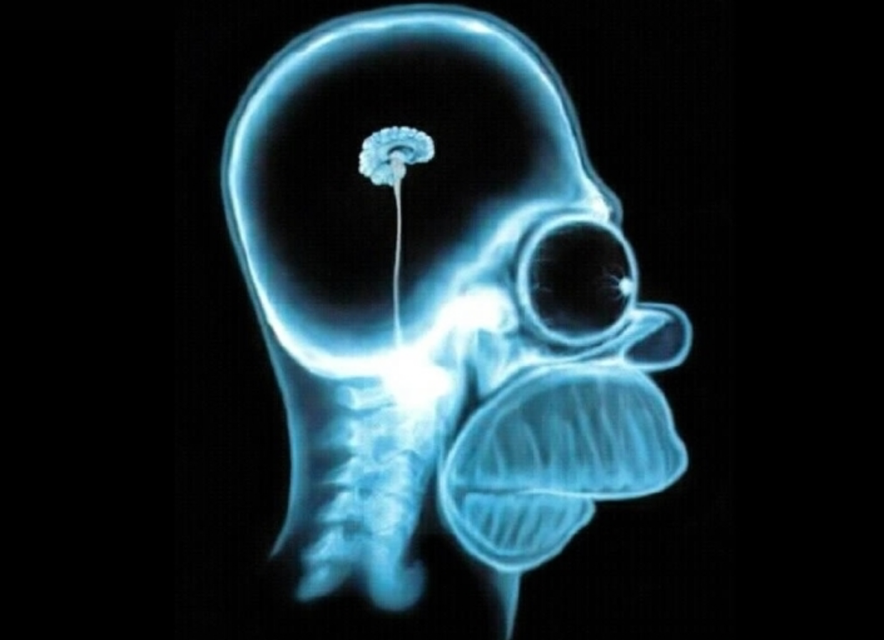
Brain Stucture and Functional Connectivity Associated With Pornography Consumption:
The Brain on Porn
Brain atrophy in the striatum (reward area: note that this is consistent with other studies on drug and other behavioral addictions)
Decreased frontal connectivity
The more hours viewing per week, the more the change in the brain
Kuhn S., Gallinat J. (2014). JAMA Psychiatry, May 28

Slide 24
Pornography impairs working memory function
“Some individuals report problems during and after Internet sex engagement, such as missing sleep and forgetting appointments, which are associated with negative life consequences. One mechanism potentially leading to these kinds of problems is that sexual arousal during Internet sex might interfere with working memory (WM) capacity, resulting in a neglect of relevant environmental information and therefore disadvantageous decision making.”
Laier, C., Schulte F.P., & Brand M. (2013). Pornographic Picture Processing Interferes with Working Memory Performance. The Journal of Sex Research. Vol 50 (7)
DOI: 10.1080/00224499.2012.716873

Slide 25
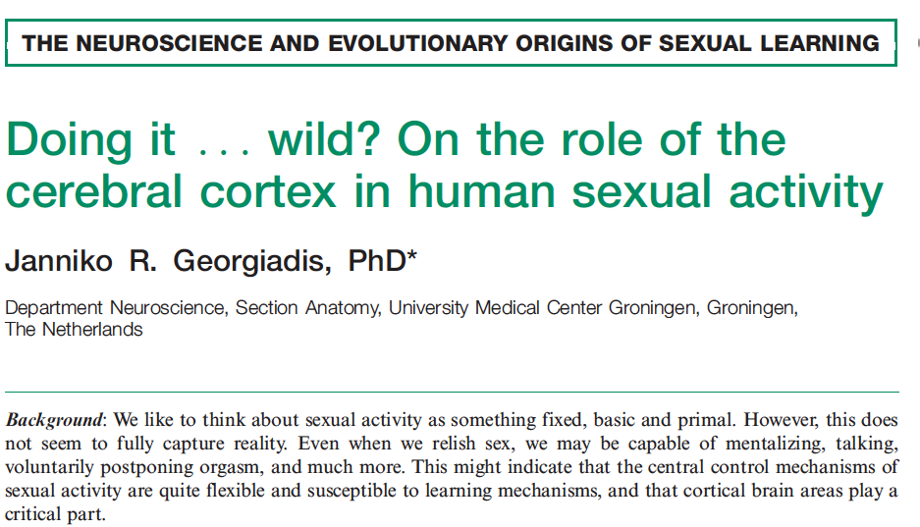
Cognitive Brain vs Limbic Brain?
No Contest!
“One of the cerebral hallmarks of high sexual arousal during genital stimulation is a steady decrease of activity in ventromedial PFC and medial temporal cortices ... It is well-documented that these areas play a critical role in moral affiliations, self-other relations, self awareness, and related behaviors…One way to conceptualize deactivation of these areas in relation to high sexual arousal is that it helps to dissolve normal body boundaries, thereby facilitating
sexual interactions. In turn, this might contribute significantly to the experience of sexual arousal.” During orgasm, activity in these areas seems to approach minimum levels and, moreover, spreads to orbitofrontal and dorsal parts of the PFC, which might at that point reflect one of the main features of orgasm, the experience of ‘loss of control’.’
Socioaffective Neuroscience & Psychology, 2012. 2:17337.

Slide 26

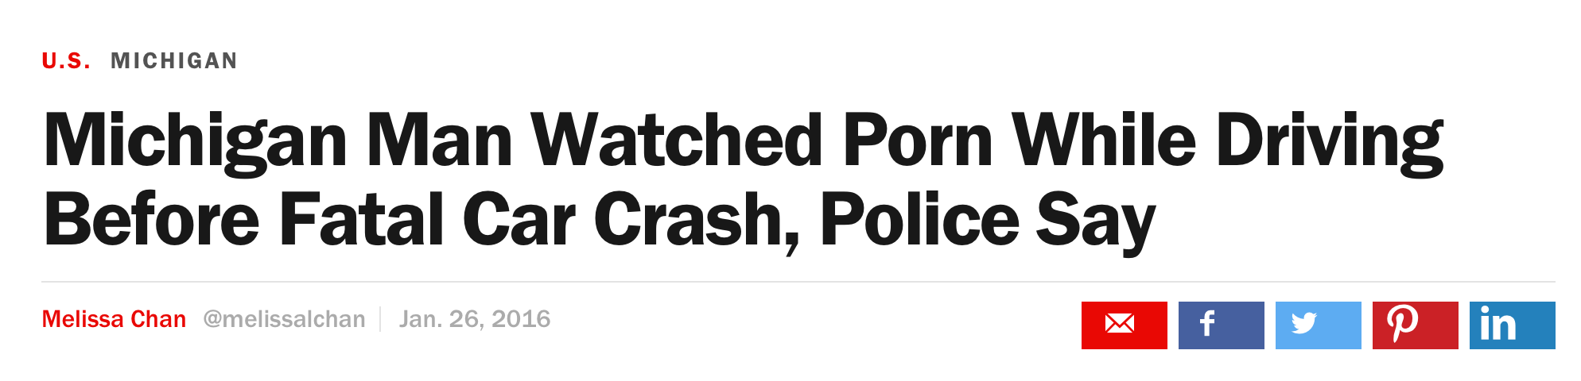
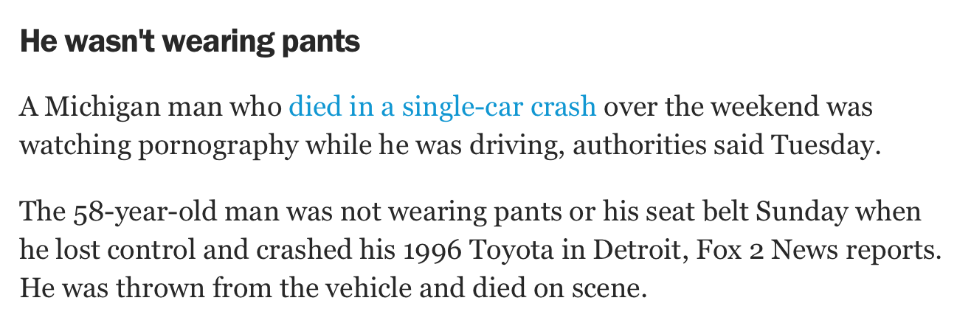
Driving while intoxicated?

Slide 27

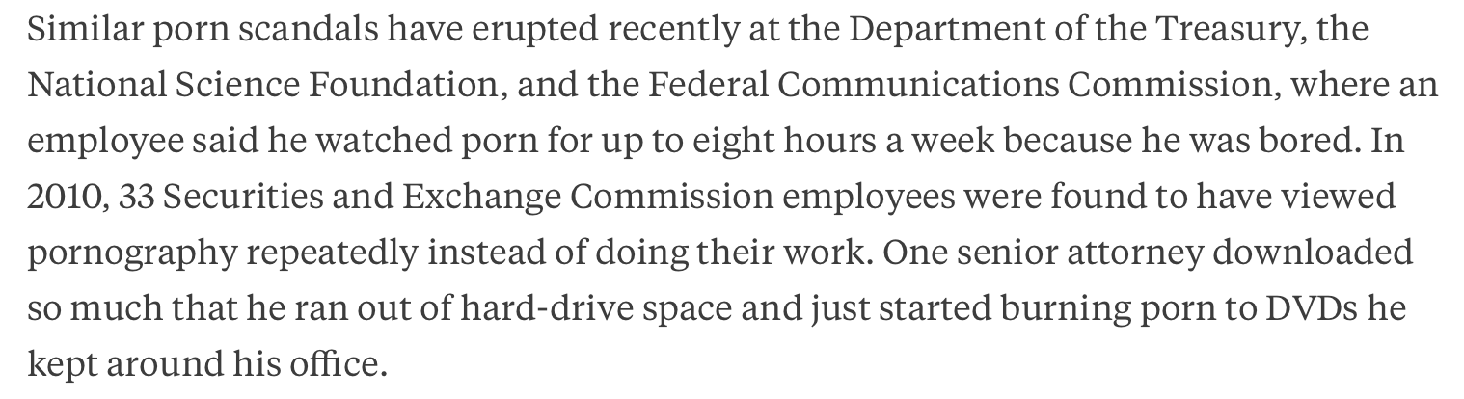

Slide 28


Slide 29


“An Israeli rabbi has given his blessing to female agents of Israel's foreign secret service, Mossad, who may be required to have sex with the enemy in so-called ‘honey-pot’ missions against terrorists.
Rabbi Ari Shvat's ruling appeared in a study, ‘Illicit sex for the sake of national security,”]’ published by the Tzomet Institute, which studies the interface between religion and modernity.”
Haaretz Oct 2010 http://www.haaretz.com/jewish-world/israeli-rabbi-honey-pot-sex-is-kosher-for-female-mossad-agents-1.317288
Thinking Brain vs Wanting Brain???
Mata Hari
Mordecai Vanunu
Notes:
Mata Hari and Mordecai Vanunu…Cheryl Hanin “Cindy”….’What is Mossad?’

Slide 30
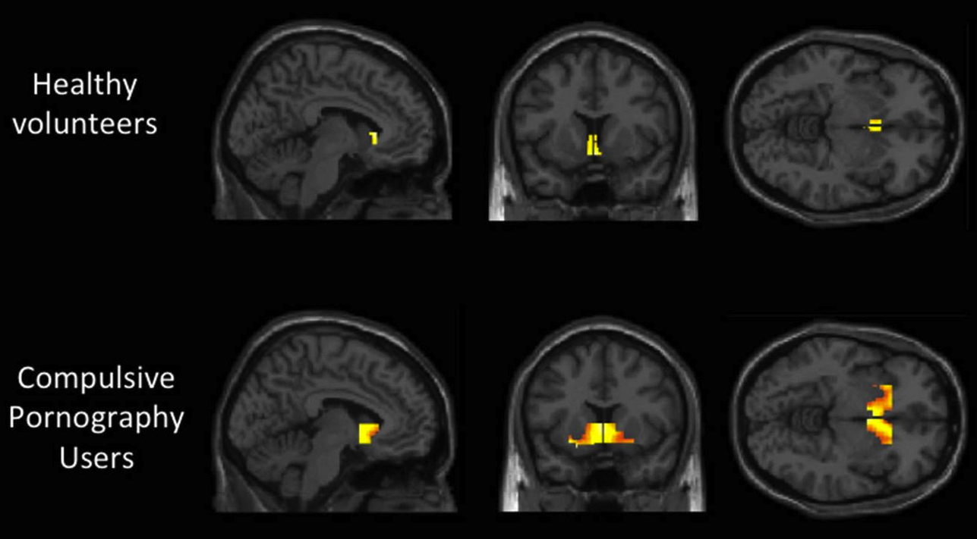
Similarities in the Voon Study between
CSB and Drug Addiction
“The dissociation between desire or wanting and liking is consistent with theories of incentive motivation underlying CSB as in drug addictions.”
“Neural differences in the processing of sexual-cue reactivity were identified in CSB subjects in regions previously implicated in drug-cue reactivity studies.
The study demonstrated a classic addiction-like wanting/liking split
Almost 6/10 experienced erectile dysfunction (with women, not with porn)
Voon, V., Mole T.B., Banca P., Porter L., Morris L., Mitchell S., Lapa T.R., Potenza M.N., Irvine M. (2014). Neural Correlates of Sexual cue Reactivity In Individuals with and without Compulsive Sexual Behaviors. Plos One, July 11, 2014
DOI: 10.1371/journal.pone.012419

Slide 31
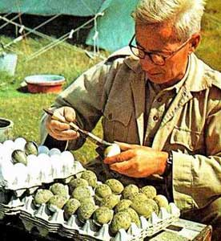
Nicholas Tinbergen
Supra-normal Stimulus
Birds and Eggs
Butterflies
Notes:
The pheromonic effect of the moths was predicted by Tinbergen’s Nobel Prize winning work with birds, butterflies, and other species, from which he coined the term “supranormal stimulus.”

Slide 32
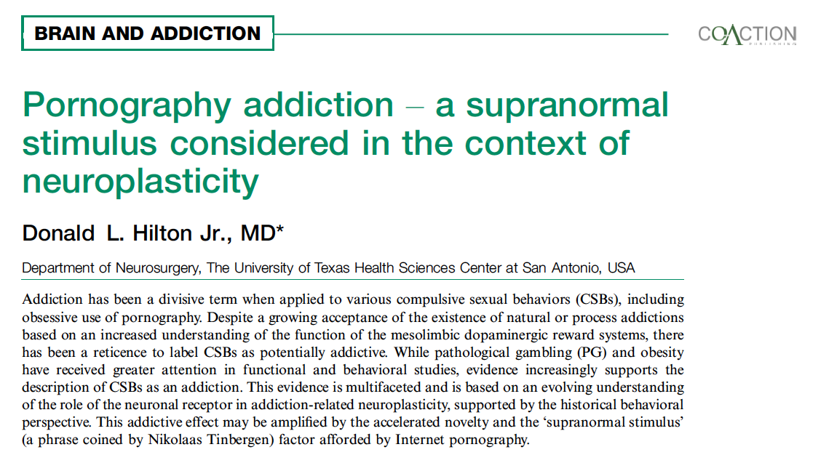

Slide 33

Notes:
It does indeed have an effect, what I like to call a visual pheromone effect. In 1869 the gypsy moth was brought to America to attempt to jump start a silk industry. Rarely have good intentions gone so wrong, as the unforeseen appetite of the moth for deciduous trees such as oaks, maples, and elms has devastated forests for the last 150 years.

Slide 34
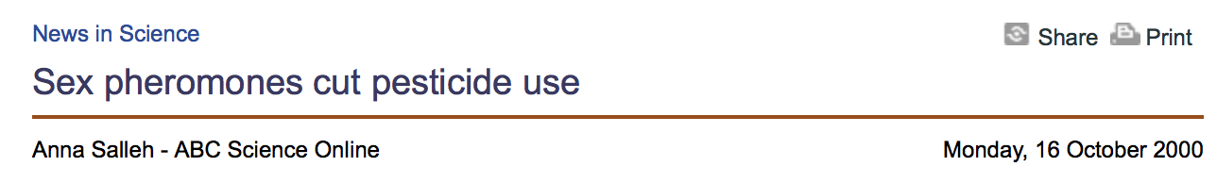
“The male either becomes confused and doesn’t know which direction to turn for the female, or he becomes desensitized to the lower levels of pheromones naturally given out by the female and has no incentive to mate with her.”
Notes:
An Australian article describes the confusion method as follows, “The male either becomes confused and doesn’t know which direction to turn for the female, or he becomes desensitized to the lower levels of pheromones naturally given out by the female and has no incentive to mate with her.”

Slide 35

Supranormal Satisfaction?
Millions ( of young Japanese men) remain at home as "parasite singles", meaning they live with, and off, their parents. The pressing need to find a partner has been alleviated by the ubiquity of porn, sex toys and virtual sex on bedroom computers – one reason, say analysts, why consumption of condoms has been falling for a decade.
Japan’s Generation X, David McNeill
The Independent June 13, 2009
http://www.independent.co.uk/news/world/asia/japans-generation-xx-1704155.html

Slide 36
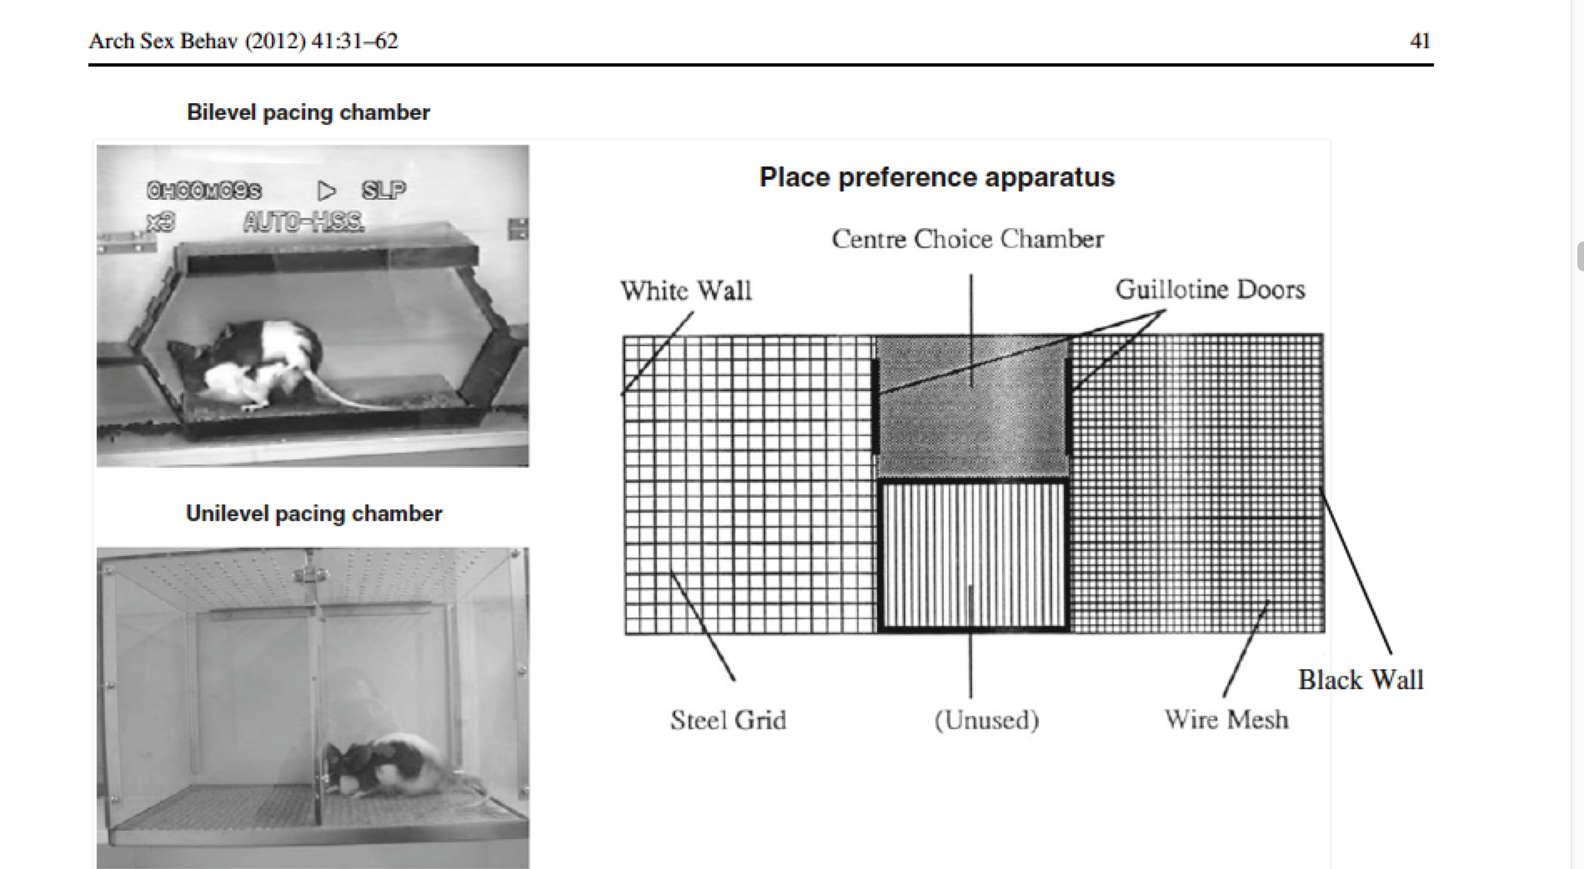
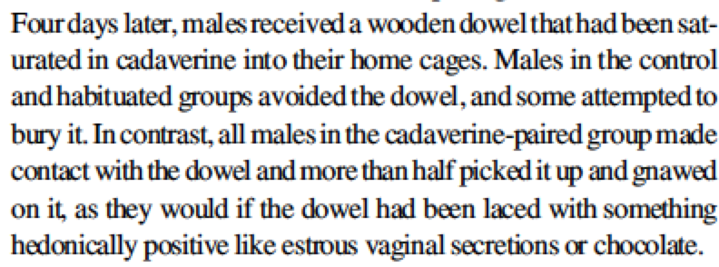
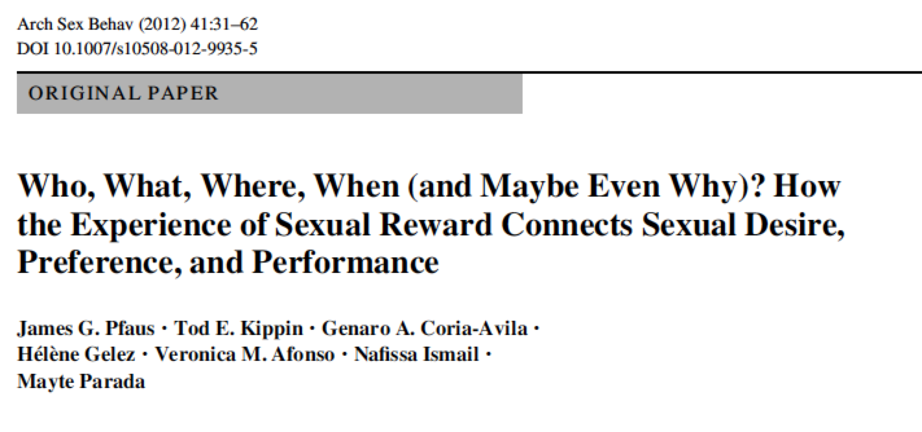
Sexual Conditioning: Learning to like the hum of a computer…
Normal rats avoid cadavarine (smell of dead bodies)
When rats are exposed to cadavarine only during sex, they learn to associate it with sex, and seek it out!

Slide 37

“We suggest that… the mirror-neuron system prompts the observers to resonate with the motivational state of other individuals appearing in visual depictions of sexual interactions.”
Mouras et al, Neuroimage, 2008
Notes:
“We suggest that… the mirror-neuron system prompts the observers to resonate with the motivational state of other individuals appearing in visual depictions of sexual interactions.” In other words, as far as the brain’s concerned, seeing is being there.

Slide 38

“I’d like to really show what I believe the men want to see: violence against women. I firmly believe that we serve a purpose by showing that.
Bill Margold, pornography performer
Gail Dines, Pornland: How Porn Has Hijacked our Sexuality. Beacon Press, Boston 2010, pg xxvi
Notes:
and Bill Margold, a famous male pornography star, is their teacher. He said:
I’d like to really show what I believe the men want to see: violence against women. I firmly believe that we serve a purpose by showing that. The most violent we can get is the cum shot to the face. Men get off on that, because they get even with the women they can’t have. We try to inundate the world with orgasms in the face.
Yet in the very act of debasing a female, the male is debasing himself. As he destroys the beauty, mystery, and majesty of her femininity through the hate sex inherent in porn, he destroys his own masculinity.

Slide 39
Top 250 Porn Titles and Aggression…
“This current study analyzes the content of popular pornographic videos, with the objectives of updating depictions of aggression, degradation, and sexual practices and comparing the study’s results to previous content analysis studies.
Findings indicate high levels of aggression in pornography in both verbal and physical forms. Of the 304 scenes analyzed, 88.2% contained physical aggression, principally spanking, gagging, and slapping, while 48.7% of scenes contained verbal aggression, primarily name-calling.
Perpetrators of aggression were usually male, whereas targets of aggression were overwhelmingly female. Targets most often showed pleasure or responded neutrally to the aggression.”
Ana J. Bridges, Robert Wosnitzer, Erica Scharrer, Chyng Sun,
and Rachael Liberman. Aggression and Sexual Behavior in Best-Selling Pornography Videos:
A Content Analysis Update. Violence Against Women 16(10) 1065-1085
Notes:
Bridges and colleagues recent paper examining the most popular and typical pornographic movies clearly shows that aggression towards women is
present in 88% of the movies. Does this have an effect?

Slide 40


Limbic drive wins in a head to head battle with cognition
Sex is progression from emotional inception to autonomic arousal...
It is always prone to sympathetic overshoot...catecholamines tend to dominate
Aggression is the end game of autonomic sympathetic arousal..

Slide 41
“Instead of experiencing the widely reported “great decline” in rape, America is in the midst of a hidden rape crisis.”
Yung, Iowa Law Review, 2014, Volume 99:1197-1255.

Slide 42

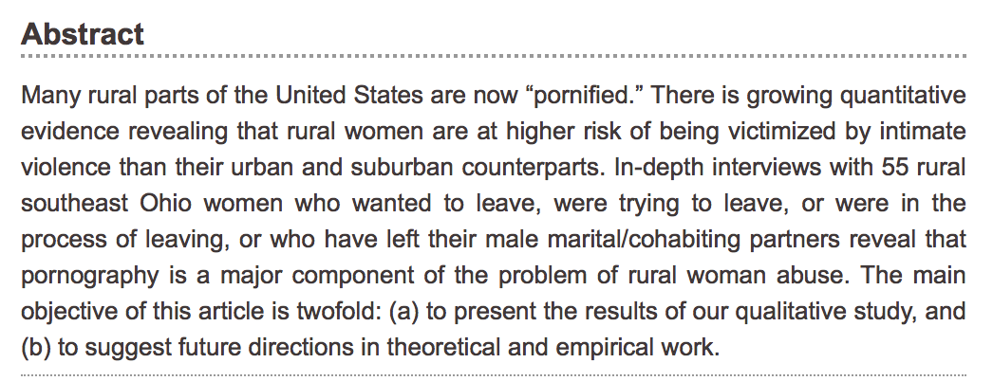
Violence Against Women, 1077801216648795, first published on May 22, 2016

Slide 43
Porn-Induced Sexual Dysfunction
“It’s hard to know exactly how many young men are suffering from porn-induced ED, but it’s clear that this is a new phenomenon, and it’s not rare.”
Abraham Morgentaler, Harvard urologist

Slide 44
Harry Fisch, MD
Cornell Urologist
The New Normal
"When I say that porn is killing America's sexual behavior, I am not kidding, nor am I exaggerating. I see the detrimental and grave effects of porn on men and women and their relationships every day in my office, and I hear about it every time I go on the radio. I'm particularly blunt about this topic because I believe porn is ...harming every aspect of sexual health… A man who masturbates frequently [to porn] can become unable to have sex.”

Slide 45
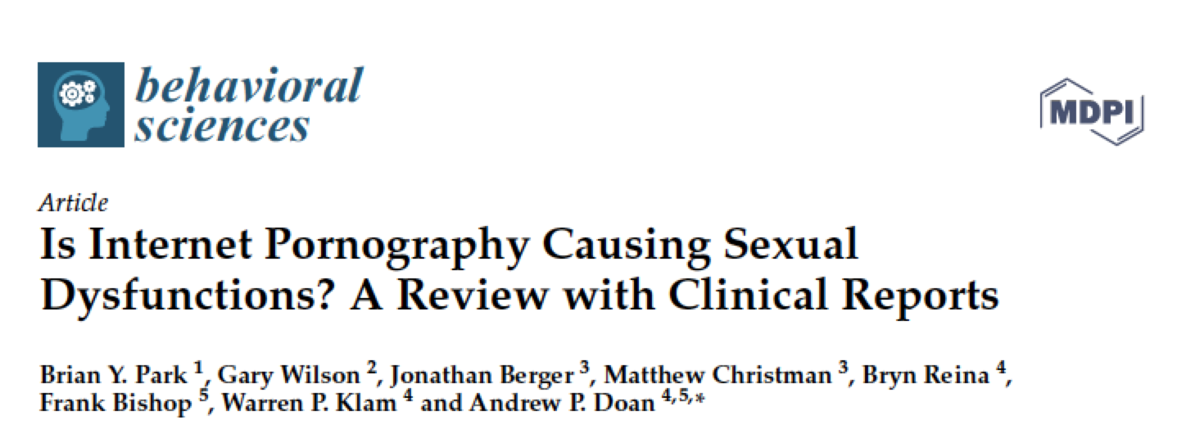

Slide 46



Multi-modal Neuroplasticity and Megaplasticity
Study published in Child Development demonstrated enhanced learning in math when teacher used hand gestures (Fenn, Duffy & Cook, 2013)
Meditation/Mindfulness Therapy/Yoga merges physical with emotional and spiritual
Musical performance enhances all learning (Kraus et al., Nature Reviews Neuroscience, 2010)

Slide 47

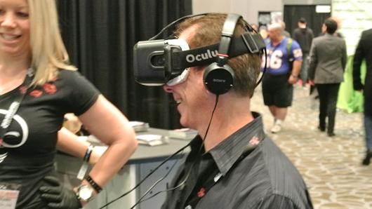
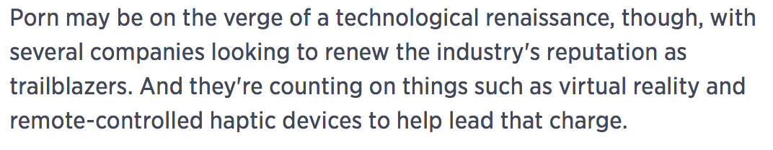
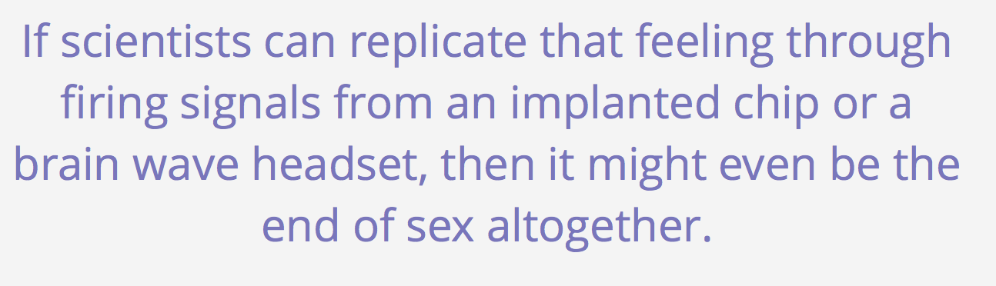
Zoltan Istvan, The Transhumanist Future of Sex
October 20, 2014

Slide 48

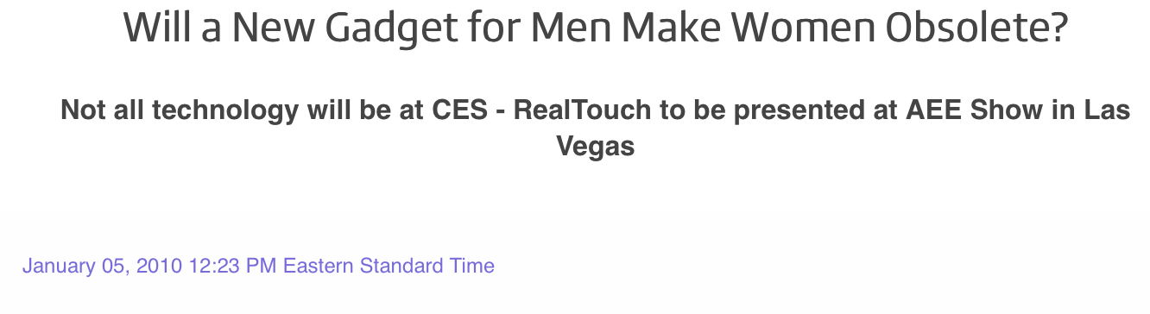


“Virtual reality porn will make 2D porn obsolete.”
Alec Helmy,
founder and president
of Xbiz

Slide 49



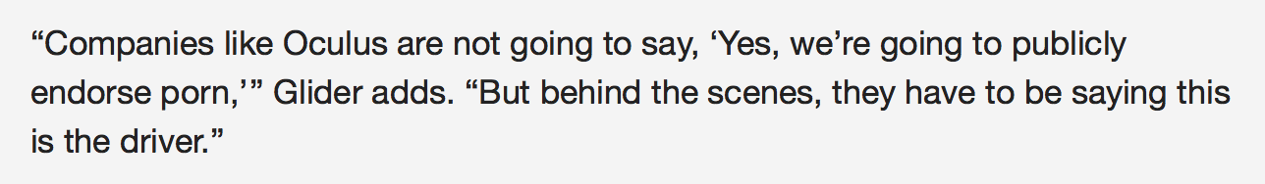

Slide 50

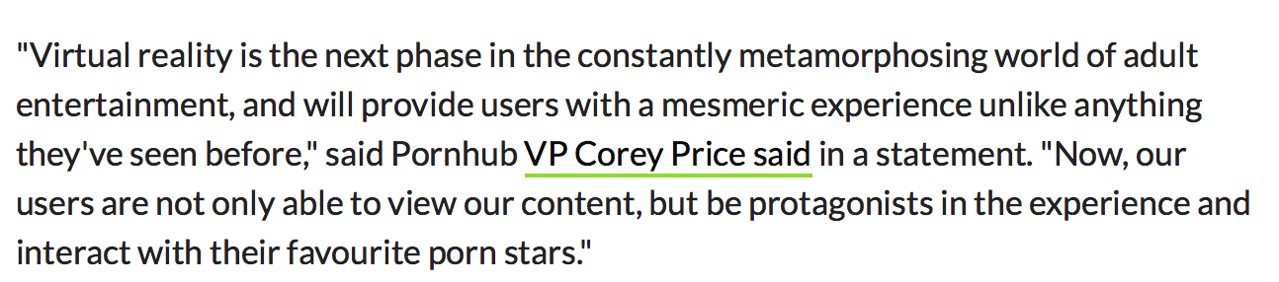

Slide 51
New ASAM Definition (2011)
Addiction is a chronic disease of the brain affecting the reward/motivation/memory systems
For the first time, addiction is defined as including non-substance addictions such as to food, sex, and gambling
In other words, sexual addiction, including pornography addiction, is a chronic disease of the brain affecting the reward/motivation/memory areas.
Notes:
The first is that addiction is a chronic disease of the brain, affecting the reward, motivation, and memory systems. Second, addiction includes compulsive destructive behaviors involving sexuality, gambling, and overeating as much as substances such as cocaine and opiates. In other words, it’s not about the behavior or substance, it’s about the brain. With this definition it would seem the debate about whether or not sex can be an addiction would be over. To the medical specialty of addiction medicine, comprised of medical doctors who have an understanding and appreciation for neurobiology and neuroscience, it is over, in the affirmative.

Slide 52
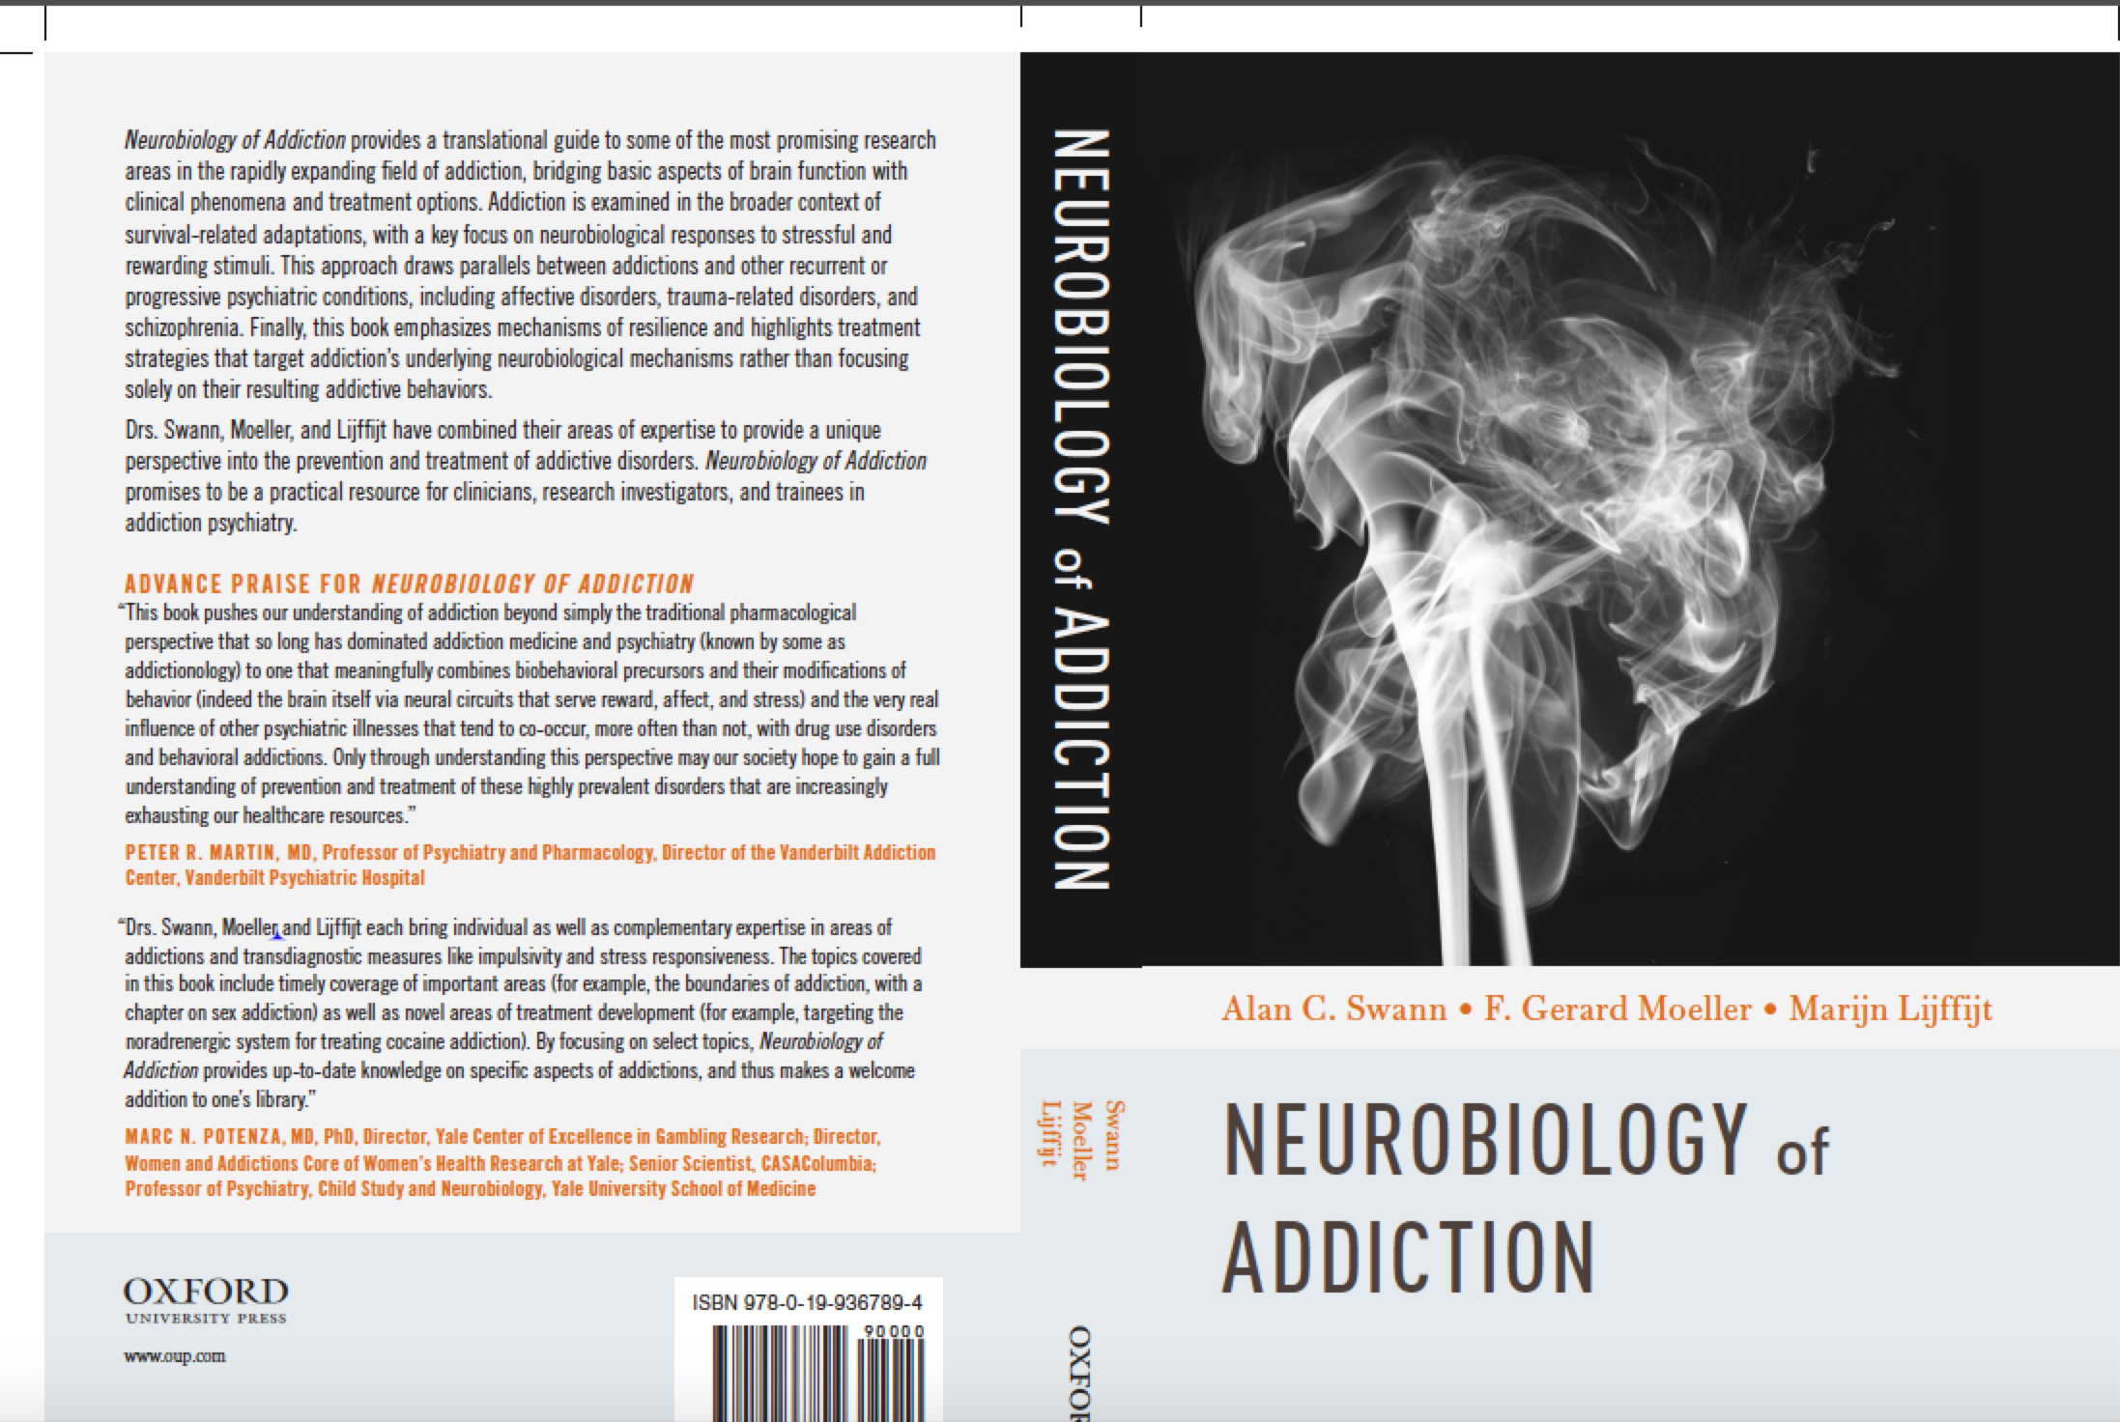
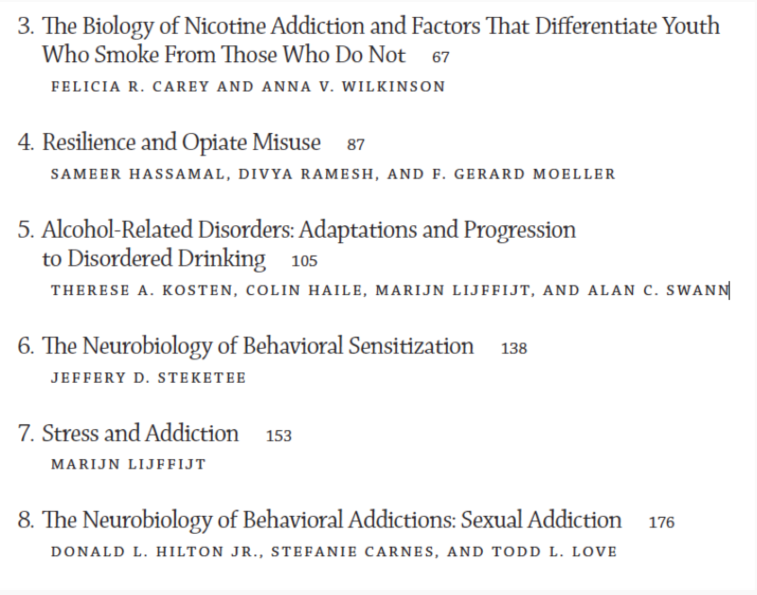

Slide 53
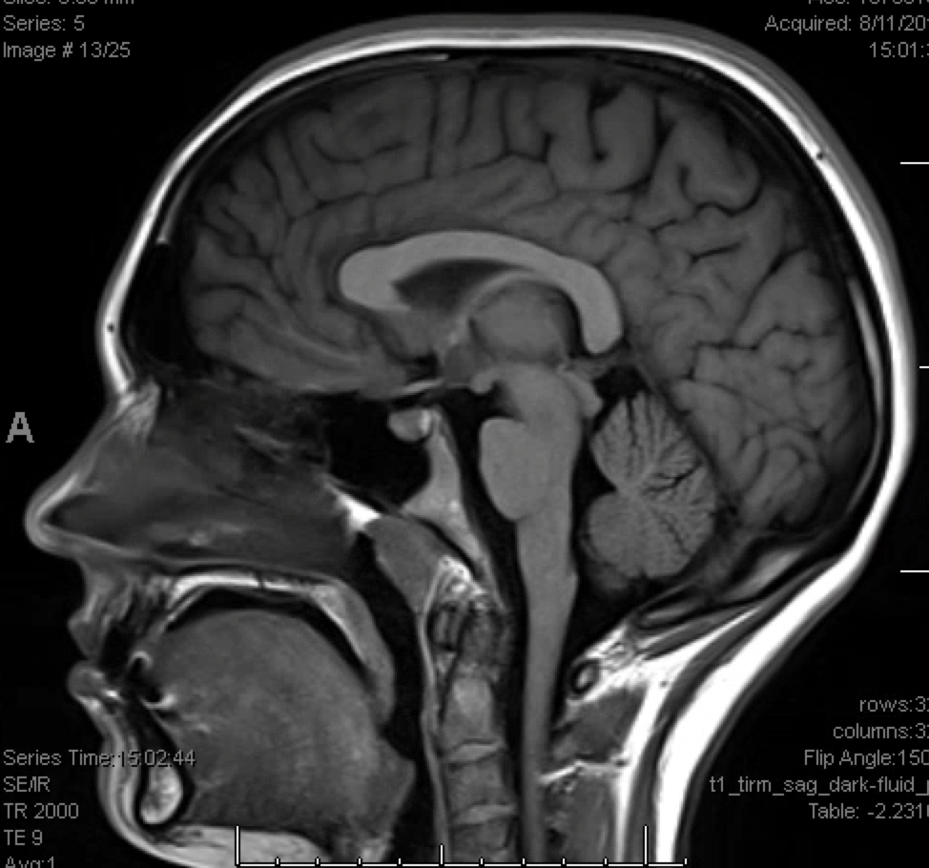
Notes:
It showed, and an MRI confirmed, that he had a colloid cyst in his third ventricle, and it was already partially obstructing one of his lateral ventricles. I asked if he had a headache, and he said, “You know, I have had increasing headaches lately.” He begged me to let him fly out of town for the upcoming Final Four, to which he had tickets and at which his favorite team, Texas, was a participant. I described, in calculated detail, how colloid cyst could cause sudden death, and instead he was in surgery the next day where I removed the cyst. It required an interhemispheric approach, splitting corpus callosum and entering the lateral ventricle. After removing the cyst I could see the striatum, and by looking through the Foramen of Monroe could see into the third and visualize the hypothalamus. Because I know this person as a fellow physician, I experienced an epiphany of sorts. I realized that in these limbic structures his personality, his wants, desires, fears, and memory were imbedded. Through these delicate and beautiful neural instruments his spirit was able to interface with the world. And I paused for a short moment of insight into who he was and who I am.
Fortunately he is still practicing as a physician today.
I started my training to become a neurosurgeon in 1988, and still remember the first time I saw the brain with me as a participant in the surgical procedure. I had read Noonan’s book about his experience following neurosurgical residents in training, and his words still capture the wonder and awe that I felt then, and even now, when I see and even touch the brain.

Slide 54

Photographer Mary Chind: June 30, 2010, Des Moines River, Iowa
Jason Oglesbee rescues Patricia Ralph-Neely (husband Alan Neely died)
Winner: Pulitzer Prize
Notes:
June 30, 2010, Des Moines River, IowaJason Oglesbee rescues Patricia Ralph-Neely (husband Alan Neely died)

