Slide 1
Pornography:
Protecting Our Children
Dr. Saran Looby
Clinical Psychologist
Saturday 15th October, 2016

Slide 2
What is Child Pornography….
Section 3 of the Children Act, 2012 defines child pornography as:
“a photograph, film, video or other visual representation, whether or not made by electronic, mechanical, artistic or other methods, that shows, for a sexual purpose –
A child engaging in explicit sexual activity or conduct;
A child in a sexually explicit pose;
Parts of a child’s body pasted to visual representations of parts of an adult’s body or vice versa; or

Slide 3
What is Child Pornography…. (cont’d)
Parts of a child’s body which have been rendered complete by computer generated images or by other methods of visual representation,
but does not include any visual representation produced or reproduced for the purpose of education, counselling, the promotion of reproductive health or as part of a criminal investigation and prosecution or civil proceedings or in the lawful performance of a person’s professional duties and functions.

Slide 4
What is Child Pornography…. (cont’d)
Section 40, Part VIII of the Children Act, 2012 also outlines the offences related to child pornography. They include:
Making, permitting, publishing, showing, obtaining access to, possessing, exchanging, or purchasing child pornography
Exposing a child or causing a child to be exposed to pornography
Arranging or facilitating a child’s involvement in pornography
The penalties for these offences are severe
and include a fine and imprisonment

Slide 5
How Children See Porn
Giving a 16 year-old boy a dirty magazine “to make a man out of him”
Child seeing pop-up ads for pornography sites when online
Child stumbling across a collection of blue movies/magazines
Showing sexts to friends or publishing sexts online
Child reading sexually explicit novels
Child watching adult movies on cable
Child sending a nude picture to boyfriend or girlfriend
Child being forced to watch pornography
Child being forced to take sexually explicit pictures or videos
Watching or trading videos of child pornography

Slide 6
Mandate of the Authority
Receiving reports
Supporting the Youth Justice System
Investigating reports
Key Functions
Licensing and Monitoring Community Residences
Assessing children
Managing the Foster Care and Adoption Systems
Determining appropriate placement

Slide 7
Child’s Journey Through the System
Reports received from Courts, Police, Hospital, Service Providers etc.
Child Protection Registry
Referred to
Partner Agencies
Investigation/Emergency Response
Court
Order
Place of Safety
Assessment Centre
Monitoring by the Children’s Authority
Treatment Plan
Treatment Plan approved by Care Committee of Board and appropriate Order requested from Court
Placement Determined Family, Fit Person, Foster Care/Adoption/
Children’s Home

Slide 8
Reported Cases of Children in Need of Care and Protection (May 2015-Feb 2016)

Slide 9
Reported Cases Involving Children and Pornography
Reports of exposure to pornography or possession of child pornography co-occurred with the following offences:
Sexual Touching Sexual Penetration
Physical Abuse Emotional Abuse
Grooming Drug Use
Possession of Fire Arms Domestic Violence
Alleged perpetrators were known to children (father, step-father, uncle, neighbour, cousin, brother, boyfriend)
Alleged perpetrators were as young as 10
Of the alleged perpetrators, 90% were male and 10% female
Alleged child victims ranged in age from 4 to 16

Slide 10
Statistics
Trinidad and Tobago
64% of the population in Trinidad and Tobago use the Internet.
United States of America
70% of children ages 7 to 18 have accidentally encountered online pornography while doing homework.
90% of children ages 8-16 have seen online pornography.
22% of teenage girls say they posted nude or semi-nude photos or videos of themselves online.
20% of all Internet pornography involves children, with more than 20,000 new images posted weekly.
Only 1/3 of households with Internet access are protecting their children with filtering or blocking software.
United Nations Statiistics Dept. GuardChild has researched and compiled a list of Child Internet Crime and Abuse Statistics from: The Pew Institute, The National Crime Prevention Center, The University of New Hampshire, Youth Internet Safety Survey, The National Center for Missing and Exploited Children, Crimes Against Children Resource Center, Child Exploitation and Online Protection, Psychologies Magazine, Project Tomorrow, FBI, Cox Communications and other resources. Accessed at wwww.guardchild.com/statistcs on Oct 9, 2016

Slide 11
Statistics
What Can We Do?
Trinidad and Tobago
64% of the population in Trinidad and Tobago use the Internet
United States of America
70% of children 7 to 18 years old have accidentally encountered online pornography while doing homework.
90% of children ages 8-16 have seen online pornography.
22% of teenage girls say they posted nude or semi-nude photos or videos of themselves online.
20% of all Internet pornography involves children, with more than 20,000 new images posted weekly.
Only 1/3 of households with Internet access are protecting their children with filtering or blocking software.
United Nations Statiistics Dept. GuardChild has researched and compiled a list of Child Internet Crime and Abuse Statistics from: The Pew Institute, The National Crime Prevention Center, The University of New Hampshire, Youth Internet Safety Survey, The National Center for Missing and Exploited Children, Crimes Against Children Resource Center, Child Exploitation and Online Protection, Psychologies Magazine, Project Tomorrow, FBI, Cox Communications and other resources. Accessed at wwww.guardchild.com/statistcs on Oct 9, 2016

Slide 12
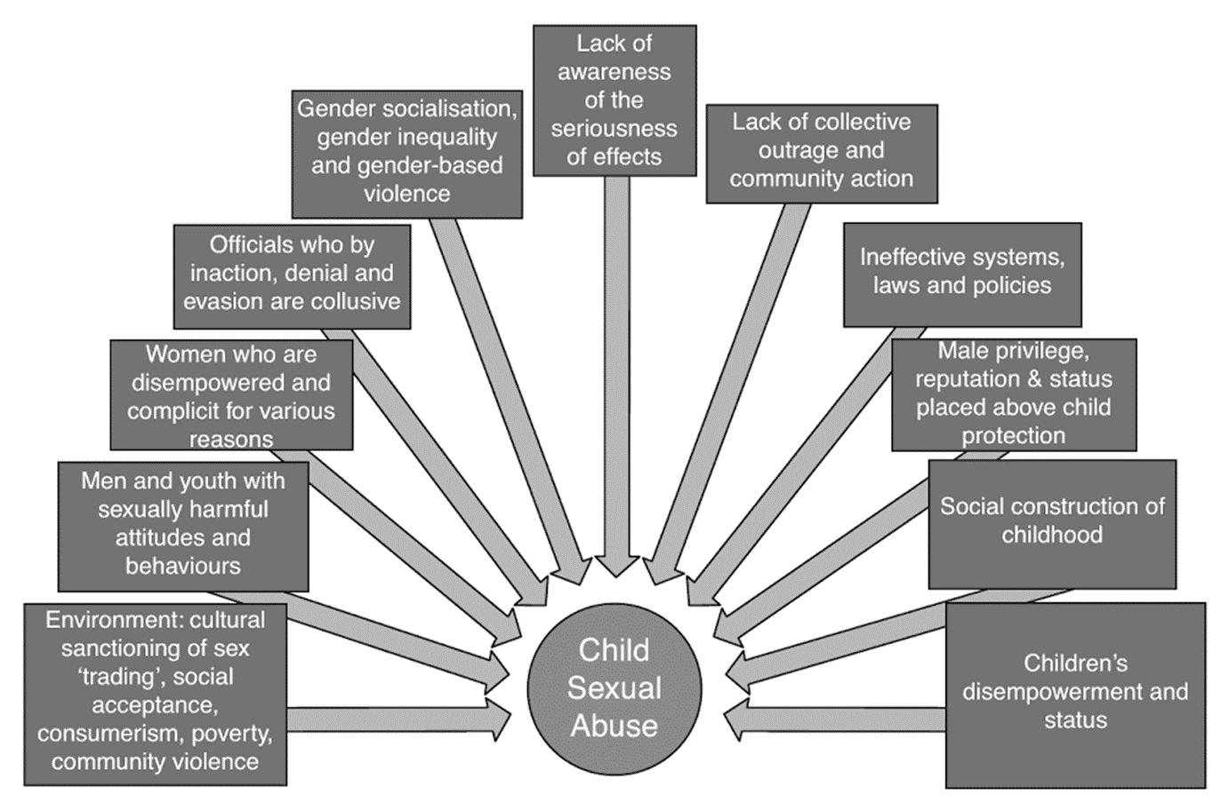
Pornography Involving Children:
Social Determinants
Porn Involving Children

Slide 13
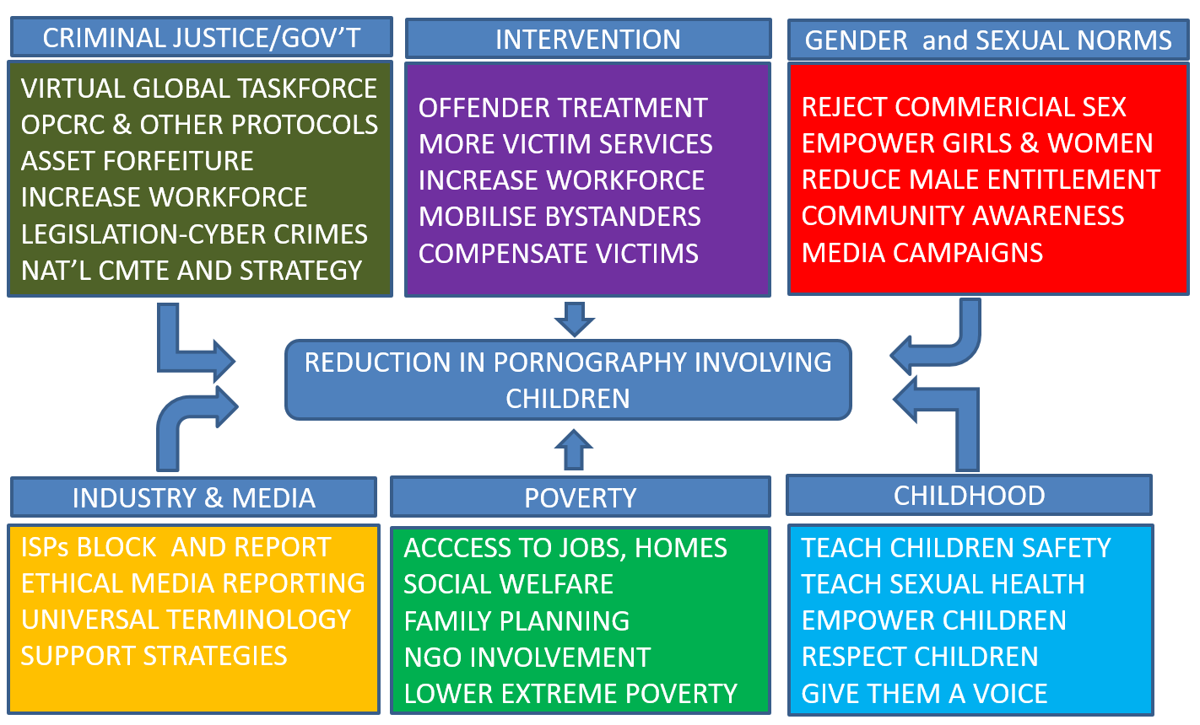
Protecting Our Children:
Societal Changes

Slide 14
Protecting Our Children:
What Organisations Can Do
For places of worship, businesses, NGOs, community or youth groups:
Implement a Child Safe Policy: Commit to child safety
Put in place strategies to promote participation and empowerment of children. Let all know to report abuse
Put in place Code of Conduct for appropriate behaviour toward children
Two-deep Leadership: No 1:1 contact with children

Slide 15
Protecting Our Children:
What Organisations Can Do (cont’d)
Screen staff. Background checks
Embed supervision and training of practices that reduce child abuse
Put in place strategies for identifying, and reducing child abuse
Codify mandatory voluntary processes for responding to and reporting suspected child abuse

Slide 16
Protecting Our Children:
What Schools Can Do
Implement a Child Safe Policy and Code of Conduct
Embed supervision & training of practices to reduce child abuse
Put in place strategies for identifying, and reducing child abuse
Codify processes for responding to and reporting abuse
Teach media literacy and ability to critique info online
Teach children to identify dangerous situations & end interactions
Sex education
Healthy Sexuality Boundaries
Body Awareness Relationships
Rights and Responsibilities Pornography and its dangers

Slide 17
Protecting Our Children:
What Parents Can Do
Deal with your own behaviour. Get help if needed
If your children can go online without your help, talk to them
Help children develop their media literacy
Teach dangers of pornography
Convey your values and beliefs
Talk to your children about their lives

Slide 18
Protecting Our Children:
What Parents Can Do (cont’d)
Talk to children about sexuality and respectful relationships
Have regular and open discussions about issues with your child
Assess people in your life. Don’t expose your child to risk of harm
Monitor your child’s interactions with everyone, especially men
Research resources and enlist others (teacher) to help you
If your child discloses: Believe, report, protect. Do not blame

Slide 19
Protecting Our Children:
What Parents Can Do (cont’d)
Stay Informed of Technology
Set Search Engine to Safe Search mode. Use Family Safety Tools
Use Parental Controls on computer and TV. No filter will stop 100%
Supervise computer use. Keep computer in open area
Teach children how to protect themselves while online
Look at your child’s browser history

Slide 20
Protecting Our Children:
What Parents Can Do (cont’d)
Know their passwords for phones, social media. Check their activity
Have child restrict social networking to friends. Keep sites private
Look at photos, texts, apps, browser history on child’s phone
Monitor and supervise books, magazines, TV shows and movies
Limit your child’s use of the phone and social media
Know your children’s friends and their parents

Slide 21
Protecting Our Children:
What You Can Do
Deal with your own behaviour. Get help if needed
Be aware of changes in a child’s:
Mood Sexual Behaviour
Interests Activities
Friends Conversation
Let children know you value them and love them unconditionally
Be a safe person to a child and respect his/her boundaries

Slide 22
Protecting Our Children:
What You Can Do (cont’d)
Be someone the children you know can talk to about anything
Check in with the children in your life
If you see/hear something, report to Children’s Authority and Police
Call the Authority’s Hotline: 996 or 800-2014
Email a report: registry@ttchildren.org
Mail a report: 35A Wrightson Road, Port-of-Spain, Trinidad

Slide 23
Thank You
Children’s Authority of Trinidad & Tobago
Tel: 627-0748
Email: info@ttchildren.org
Website: www.ttchildren.org
HOTLINE: 996 or 800-2014
Registry Email: registry@ttchildren.org
Communications: 627-0748 ext. 2100
Communications Email: communications@ttchildren.org

