Slide 1
Marginalized. Masked. Missed.™
Sexual Exploitation: Connecting the Dots in Real Life.
“The Intersection of Child Pornography and Human Trafficking”
Consider This! A National Conversation
On Protecting Our Children from the Harmful Effects of Pornography
October 15-16, 2016
Trinidad and Tobago, Port of Spain

Slide 2
An Important Message from the Presenter.

Slide 3
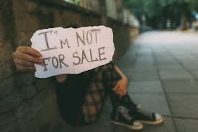
Pornography | Human Trafficking
One of the largest criminal enterprises in the world involving human beings as a commodity for profit.
A person can be sold, traded and exploited across multiple trafficking schemes over and over again, making the trafficking of persons a lucrative business with less risk than arms and drug dealing, but an even more dangerous enterprise for individual victims, families and communities.
Criminal activity which involves complex victimization across multiple trafficking and exploitive schemes.

Slide 4
Child Trafficking Schemes
Prostitution | Escort Services
Commercial | Residential brothels
Traveling Sales Crews
Peddling Ring
Hair Braiding Salons
Homes – Domestic Servants
Gangs – (drugs | theft | guns)
Marginalized Communities
Agriculture | Seasonal Work
Strip Clubs | Exotic Dance Clubs
Child Pornography | Sex Tourism
Phone Sex Companies | Internet
Restaurants | Construction sites
Families | Child Brides
Educational Institutions
Sports | Entertainment

Slide 5
Trafficking Schemes
CHILDREN
&
YOUTH
Child Pornography
Sex Trafficking
DMST - CSEC
Societal Norms
Services
Family
Dynamics
Labor Trafficking/Domestic Servitude
Communities
Child Welfare Systems
Justice Systems

Slide 6
Moving Vulnerable Populations from the “Margins” to the “Middle”
Masked
Missed
Marginalized
INTERSECTIONALITY

Slide 7
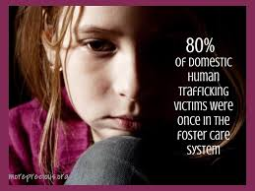
Vulnerable Populations in Child Welfare Systems
Detention Centers
Justice-Involved Youth
Foster Care | Shelter Care
Residential Treatment Centers
Transitional living group homes
Transitional living apartments (aging | aged out)
MINORITY

Slide 8
Marginalized
How the intersection of Social Determinants contribute to the vulnerability of marginalized populations, making them an easy target for child pornography and intersecting human trafficking schemes.
Individuals
Families
Communities
Tricked. Traumatized. Trafficked.™

Slide 9
Health Disparities
Poverty
Education
Access to Health Care
Access to Mental Health
Chronic Illness
STI | STD
Sexual Violence
Communicable Diseases
Physical Injuries
Employment/Unemployment
Food Deserts
Access to Transportation
Access to Education
Access to Stable Housing
Access to quality education
Drop-out | School to Prison
Digital Divide
Vision | Hearing
Intellectual Disabilities
Developmental Disabilities
Societal Norms
PORN CULTURE & HUMAN TRAFFICKING
Intersectionality
TRAUMA
VULNERABILITIES
Race, Ethnicity, Culture
Linguistic, Faith, Family
Gender, Sexual Identity
Personal | Property Crimes
Incarceration
Drugs | Alcohol
Prostitution | Loitering
Debtors Court
Socioeconomics
Bipolar | PTSD
Addictions
Family History
Stockholm Syndrome
Suicide | Suicidal Ideation
Cutting | Other
Natural Disasters
Community segregation
Physical | Social barriers
Exposure to toxins |hazards
© Sunny Slaughter Consulting 2016
Social Justice
Environmental
Mental Health

Slide 10
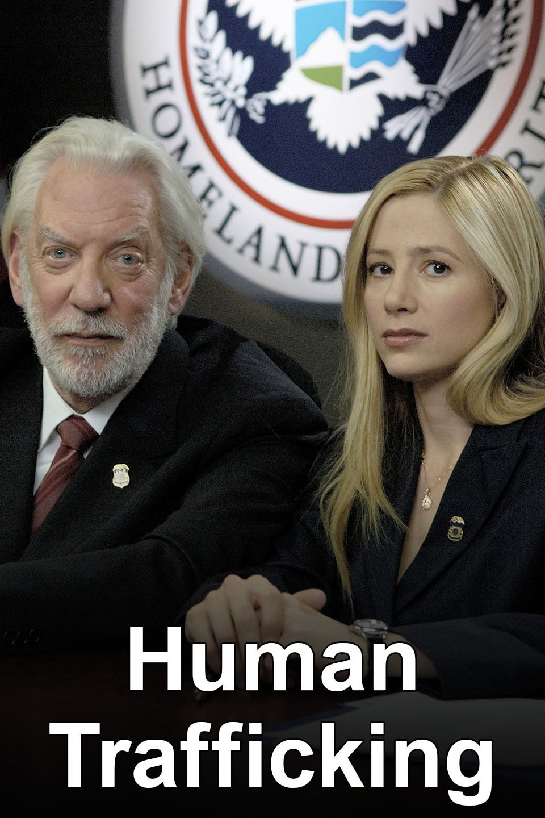
The MYTH: Media and Messaging on “the face” of
Human Trafficking

Slide 11
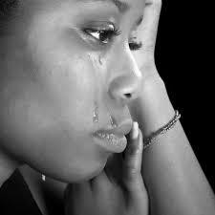
Masked
Foster Care | Aged-Out **
Runaways |Throwaways
Justice-Involved Youth
Homeless | Transient
LGBTQ (all other self-identified)
Intellectual |Developmental Disability
Mental Health (Diagnosed |Undiagnosed)
Teen Parents
Unemployed | Employed
​Victims with addictions
Victims of other crimes
Minority – Racial | Ethnic | Linguistic

Slide 12
Cultural Competency
Child
Race
Ethnicity
Culture
Faith
Responsive Delivery of Care

Slide 13
Missed
Recognize the additional barriers created by human trafficking victimization which are missed “Opportunities” to close the gap between maltreatment which brings children “into” the purview and care of CWS and Justice Systems, and those exacerbated or created while “within” the care of CWS and Justice Systems.

Slide 14
TIC Response Teams
Trauma Informed Care Response Teams are designated individuals across multiple disciplines who are highly skilled, trained and prepared in the complexity and nuances of child pornography/ human trafficking criminal behavior and victimization.
Team members can work with victims of all forms of human trafficking.
Represent a broad spectrum of cultural, racial and ethnic diversity to assess and assist individuals, families and communities in responsive delivery of appropriate services and support.
Vet, verify and coordinate service providers and organizational programs for engagement with victims.

Slide 15
Checking the Boxes!
The maltreatment and abuse of children requires the intervention of multiple agencies that are responsible for providing clear, concise and consistent policies, practices and processes, which meet the needs of “individual” victims, while taking into consideration the racial, cultural, ethic and linguistic necessities of the victims family. This allows them to live free from harm, reduce trauma and barriers, and in a way that is respectful of their rights to survive and thrive within their own societal structure.

Slide 16
Policies that are specific for identifying, assessing and responding to human trafficking victimization and exploitation which is often exacerbated by CWS.
Compliance with all laws and timelines relating to reporting, monitoring and training.
Vetting and verifying new and existing service providers which may be used to assist and support victims of human trafficking and their families.
Identifying gaps in existing policies and services.

Slide 17
Comprehensive training and assessment of staff who are “specifically” best suited to respond to human trafficking victimization.
Review of professional ethics and organizational practices to ensure cultural competency, diversity and inclusion for delivery of care for human trafficking victims and families.
Establish best practices that are specifically designed to meet the individual needs of human trafficking victims while addressing the vast nuances which exacerbate trauma and vulnerabilities experienced by human trafficking victims.

Slide 18
Effective and efficient processes which allow for better monitoring of children and families engaged in systems.
Identifying, training and monitoring of families and agencies to deliver culturally competent services and support to children who have been exploited or trafficked.
Streamlining reunification, foster-care and adoption services which allow for stabilization of children who are at greater risk for exploitation.
What new systems are required for organizations and service providers to be in compliance with laws and organizational policies.

Slide 19
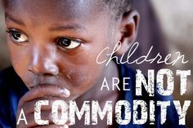
DO NO HARM!
Promote transparency, work to reduce failures, close gaps and provide fluid services best serve children and reduce further fracturing of a child’s future.
“It takes the courage of the collective conscience, that refuses to contribute to the continued unethical behaviors of individuals, organizations and systems, that ignore the needs of marginalized minority children who are at increased vulnerability for human trafficking schemes.” sss
Be a Voice and Champion for ALL children who are Tricked. Traumatized. Trafficked.™

Slide 20
What are YOU really willing to do for OTHERS?

Slide 21
Presenter Contact Information
Sunnetta “Sunny” Slaughter
CEO/Principal Consultant
Sunny Slaughter Consulting, LLC
SME/Human Trafficking Expert
DHS Law Enforcement Instructor | Consultant
Website: www.sunnyslaughter.com
Phone: 205-538-1422
Email: thesunnyslaughter@gmail.com
LinkedIn: Sunny Slaughter

