Slide 1
Winning the Fight Against Pornography in the U.S.
Dawn Hawkins, Vice President & Executive Director, National Center on Sexual Exploitation

Slide 2
Child advocacy and Internet safety leaders
Pro-family organizations
Prevention & education groups
Women’s rights and feminist activists
Recovery groups for survivors, addicts, loved ones
Law enforcement
Mental health and science experts
Anti-trafficking groups
State policy groups
Technology and filtering companies
Religious leaders
and more...

Slide 3
A Change in Messaging

Slide 4
A Change in Messaging

Slide 5
The Dirty Dozen List: Naming, Shaming & Changing Groups Who Facilitate Sexual Exploitation

Slide 7
DirtyDozenList.com

Slide 8
More than 85 actions you can take right from home in minutes!

Slide 9
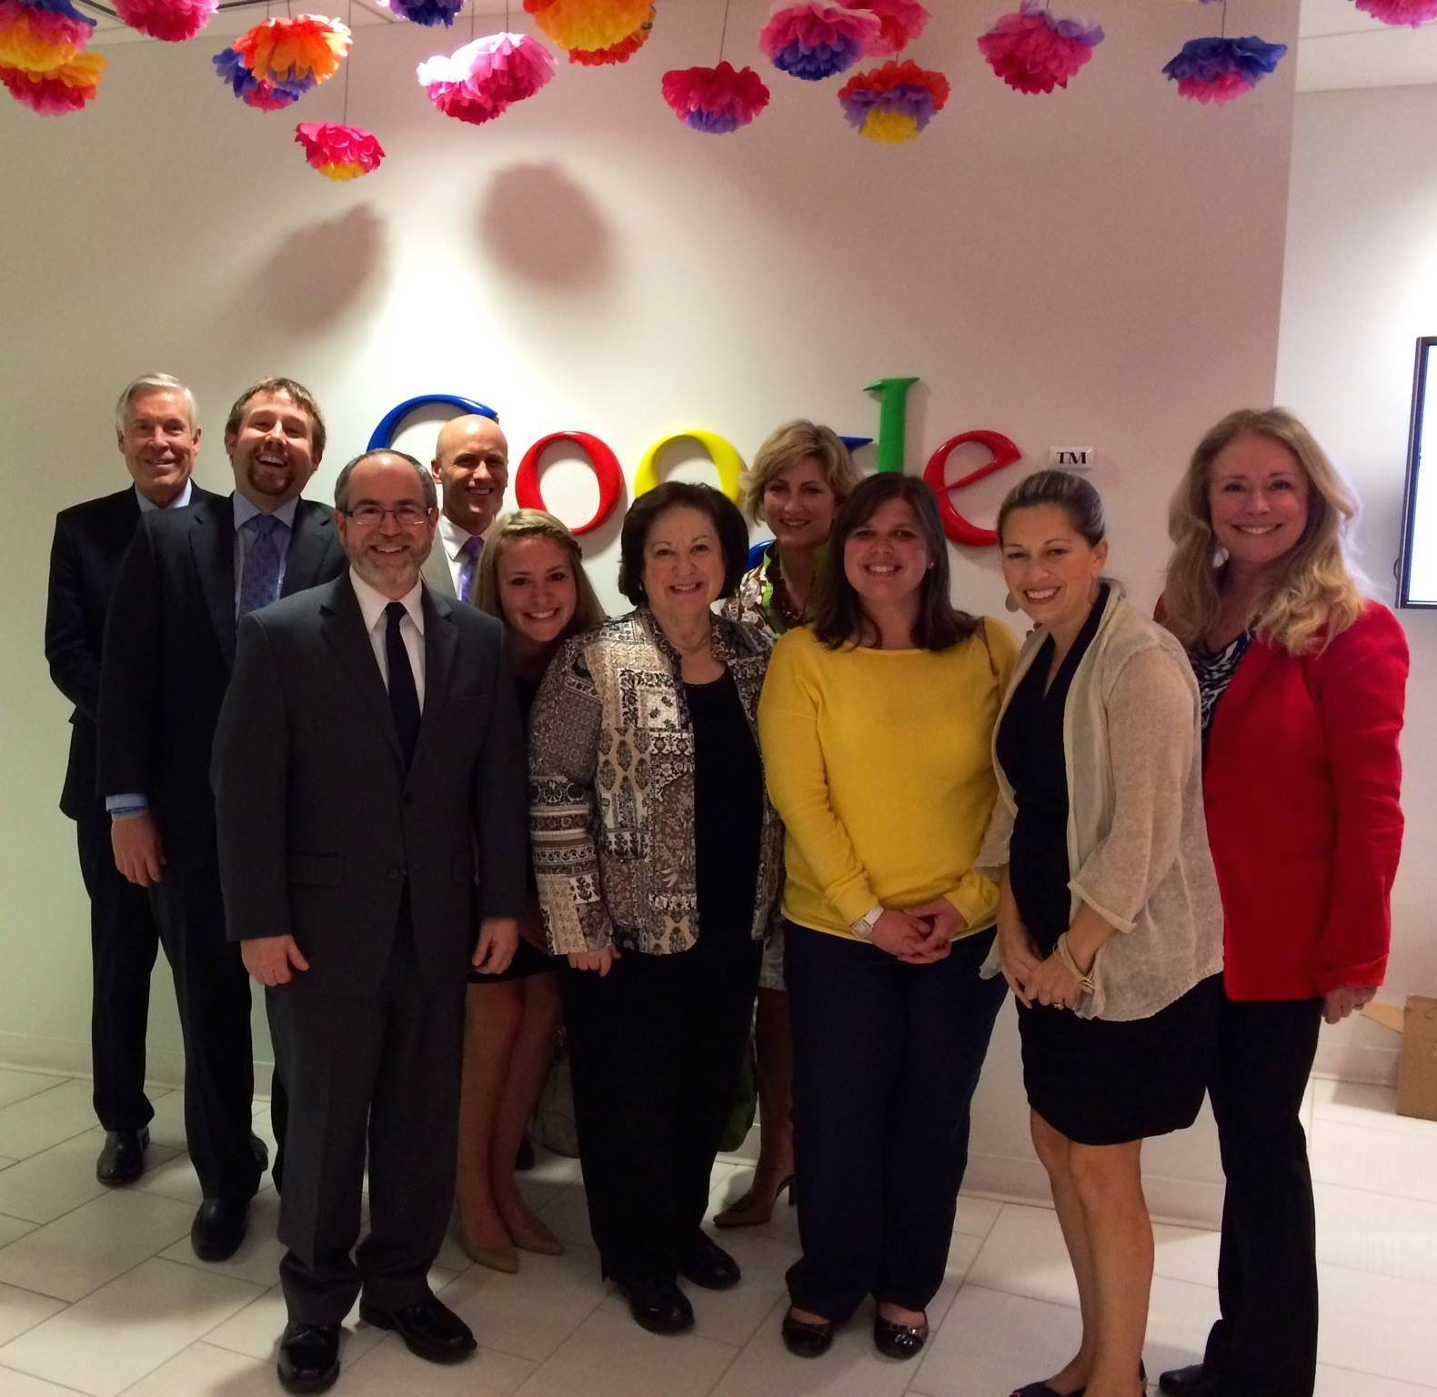
VICTORY: Google

Slide 10
VICTORY: Hotel Industry
2011-2015 - Marriott commented that the decision is strictly based on economics: In-room porn profits have steadily declined because the porn industry has moved online.
2015 - A statement from Hilton Worldwide said: “We are making immediate changes to our global brand standards to eliminate adult video-on-demand entertainment in all our hotels worldwide…we have listened carefully to our customers and have determined that adult video-on-demand entertainment is not in keeping with our company’s vision and goals moving forward.”
2016 - IHG Spokespersons stated: “Through our discussions with NCOSE, we were able to identify ways to better assess and strengthen our compliance standard prohibiting the airing of NC-17 content or equivalent, which includes increased communications to hotels and rigorous audits. This further bolsters dialogue we have had for several years with numerous governmental and non-governmental organizations on a range of initiatives designed to safeguard human dignity—from supply chain protocols and human rights to sexual exploitation.”

Slide 11
VICTORY: U.S. Military
U.S. Army and Air Force stopped selling pornography in all base exchanges
Frequent searches ordered to ensure that all pornographic and sexually explicit and objectionable content is removed from public and work spaces
More military bases filtering Internet access to prohibit pornography access

Slide 12
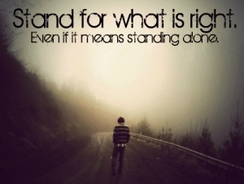
"The world will not be destroyed by those who do evil, but by those who watch them without doing anything." - Albert Einstein

