Slide 1
THE harm OF adult PORNOGRAPHY to CHILDREN 2016
Sharon W. Cooper, MD FAAP
Department of Pediatrics
University of North Carolina Chapel Hill
School of Medicine
Womack Army Medical Center
Fort Bragg, NC

Slide 2
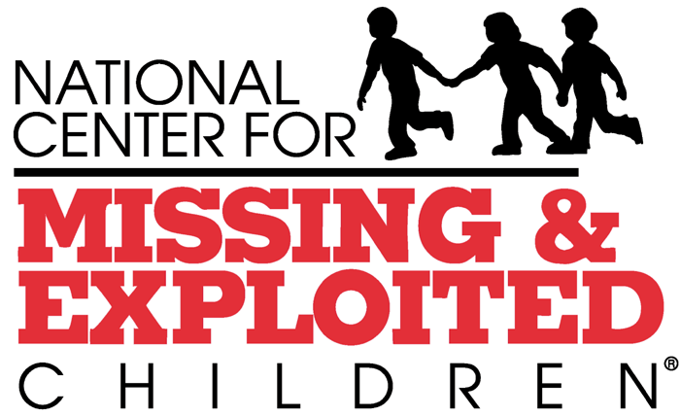

Slide 3
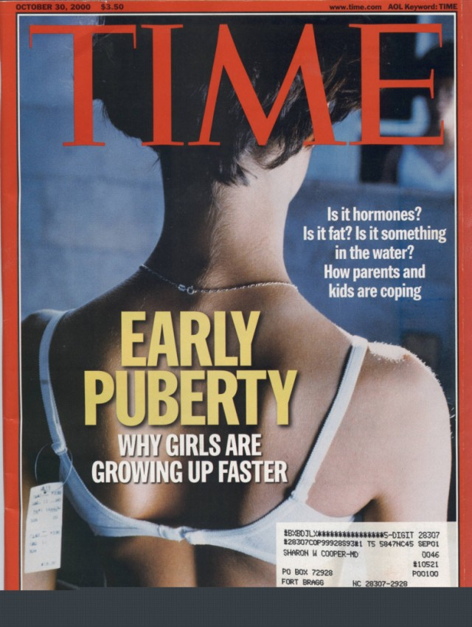
PRO-Medical-Cooper-55

Slide 4
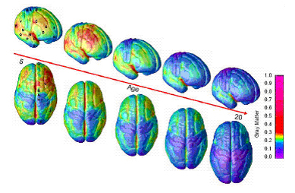
Site Index | Site Guide | Staff Directories | Contact NIMH | Copyright | Policies | FOIA
The National Institute of Mental Health (NIMH) is part of the National Institutes of Health (NIH), a component of the U.S. Department of Health and Human Services.

Slide 5
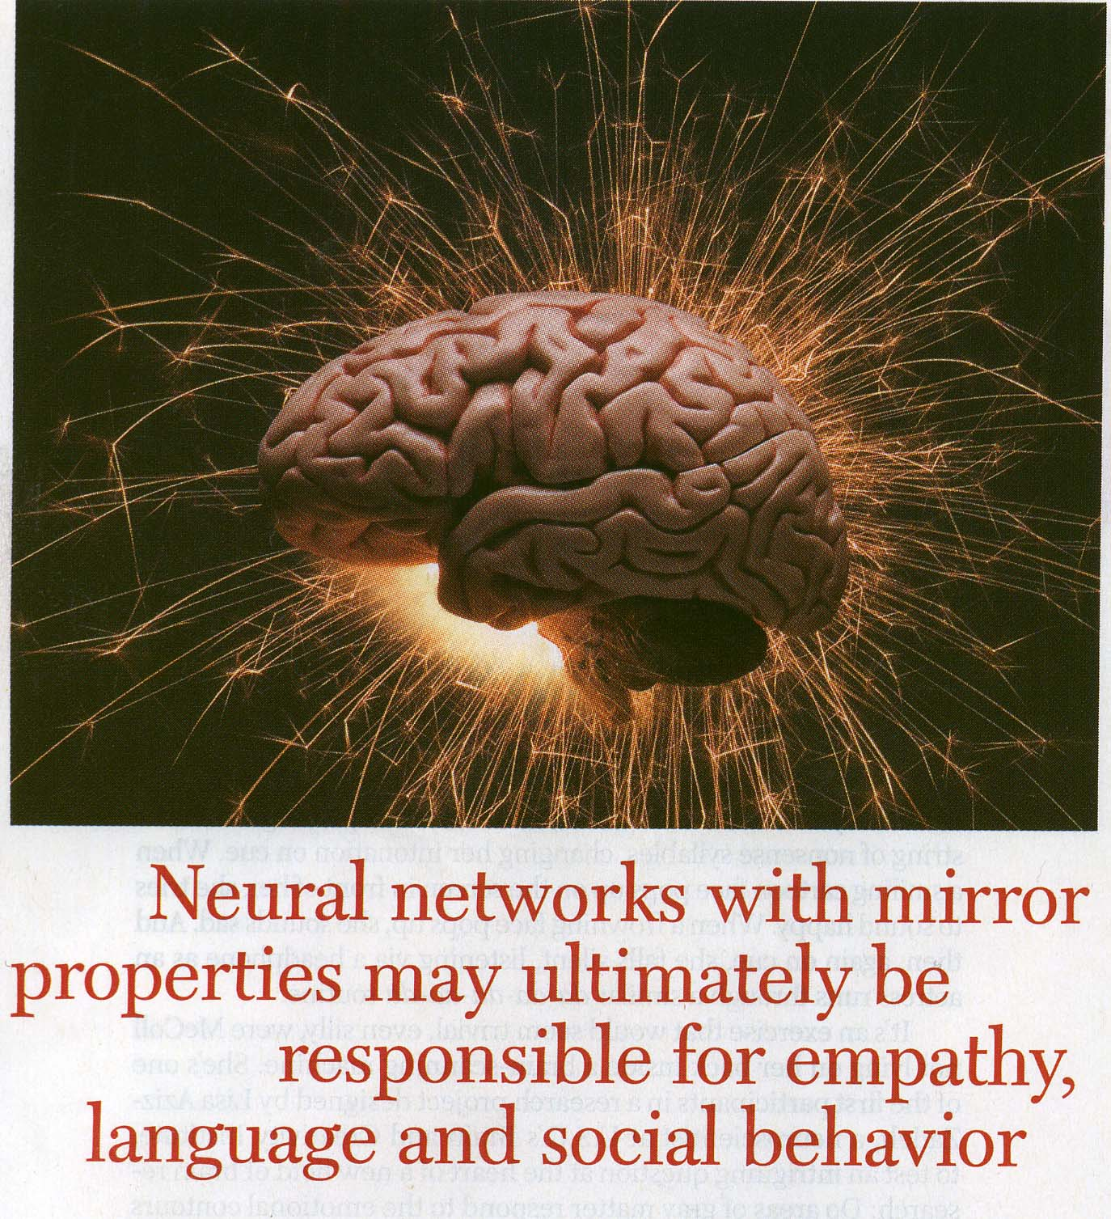

Slide 6
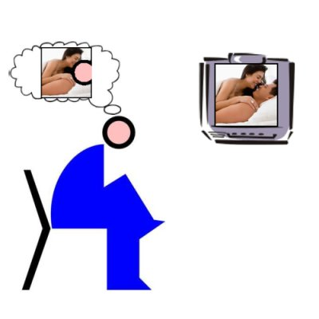

Slide 7
The Perfect Storm
Shockless Society
ONLINE BULLYING
Adolescent Mental Health Dysfunction
Sexual
Violence
NORMALIZED
SEXUAL HARM
Runaway and
Homeless Youth
Ethnic Poverty
CYBERSTALKING
CHILDHOOD
ADVERSITIES
Gang Culture
Technology
Improvements for
Pay-for-Use
Drug
Addiction
ONLINE DATING SITES
Sexual Addiction
and
Dysfunction
Social Network Recruiting
Predator University

Slide 8
HARM TO CHILDREN
ADULTS WHO VIEW (AP) AS A PLAN FOR CHILD SEXUAL ABUSE
ADULTS WHO USE (AP) TO ENTICE YOUTH TO SELF-PRODUCE
ADULTS WHO SHOW (AP) TO CHILDREN FOR SEXUAL “EDUCATION” AND SEDUCTION
TEENS WHO VIEW (AP), BECOMING EXCITED AND EVEN HABITUATED WHO THEN OFFEND AGAINST CHILDREN
TEENS WHO VIEW (AP) AND SEXUALLY ASSAULT PEERS AS A PLAN FOR DATING VIOLENCE
TEENS AND CHILDREN WHO VIEW (AP), LOOK FOR “BARELY LEGAL’” IMAGES AND THEN CHILD SEXUAL ABUSE IMAGES
ADULTS WHO VIEW (AP) AND MAKE SEXUALLY EXPLICIT MATERIALS TO NETWORK WITH LIKE MINDED OTHERS

Slide 9
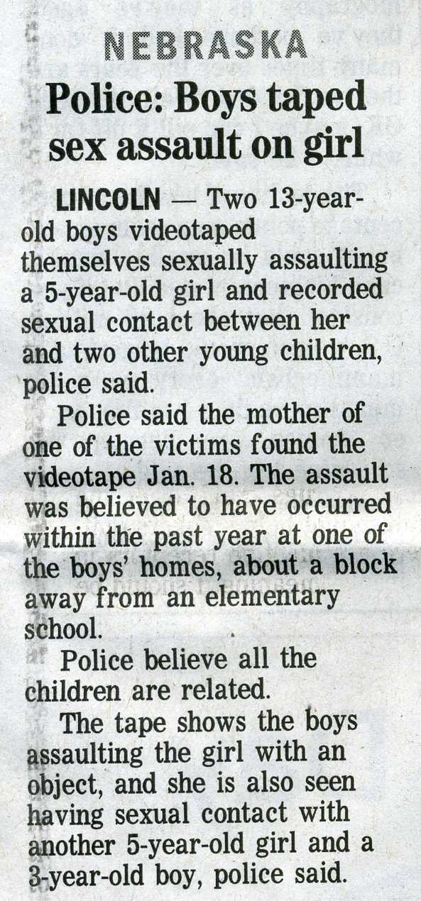
CHILDREN LEARN WHAT THEY SEE….. ???

Slide 10
OR …
“WHAT YOU SEE,
IS WHAT GETS
YOU”
(Iman El Amin,
Baltimore, MD
Defending Childhood Task Force Testimony
2014)

Slide 11
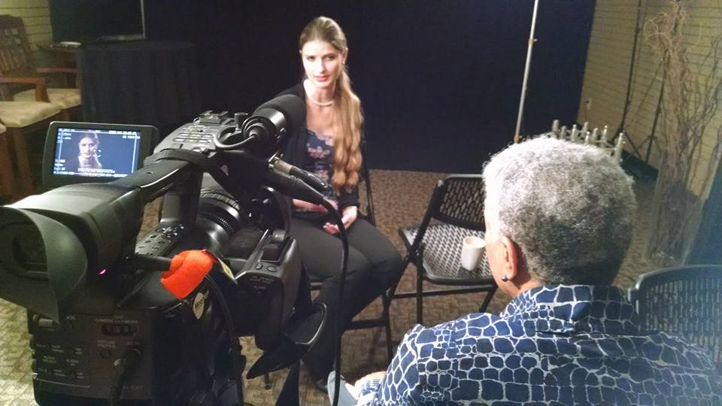
DISCOVERY TO RECOVERY

